Slide 1


Elder Abuse Guide for Law Enforcement
Elder Abuse in Your Community
Notes:
Presenter:
This presentation is for you.
Slides can be Customizable
Remember to:
Welcome participants
Introduce speakers
Time permitting ask participants to state their name, precinct and years of service.

Slide 2
Training objectives
By the end of today’s session, you should be able be able to:
Differentiate and understand the elements of elder abuse including, risk factors, types, prevalence and signs
Recognize the impact of elder abuse in your own community
Comprehend the multi-disciplinary approach to various elder abuse cases
Use EAGLE to identify, intervene and resolve cases of elder abuse
Notes:
Presenter:
This slide is to provide an overview of the training so that participants have a sense of all elements of the session.
Presenter:
This training serves as an introduction into the crime of elder abuse and all of the component parts. Financial Abuse and Physical Abuse are more familiar to LE, however, Sexual Abuse, Emotional Abuse and Neglect are very real and very serious aspects of elder abuse.
Part 2 will provide techniques that will be helpful to LE to have meaningful conversations with older adults that will further their case and evidence collection.
Part 3 will provide an introduction to the Elder Abuse Guide for Law Enforcement module and engaging case studies to understand how EAGLE can strengthen and support this important work

Slide 3
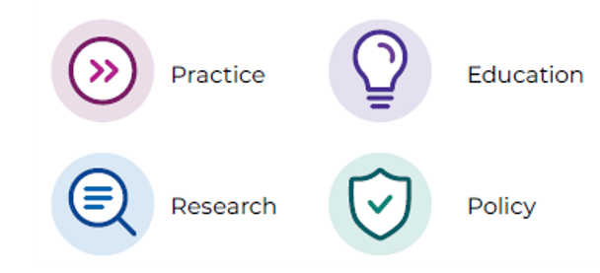




Training Developed By:
The NCEA strives to improve the national response to elder abuse, neglect, and exploitation.
The NCEA does so through—
The National Center on Elder Abuse (NCEA)
https://ncea.acl.gov/
Notes:
Presenter:
This training was developed by experts at the National Center on Elder Abuse via a generous grant from the Department of Justice DoJ.
NCEA serves as a national authority on elder abuse, neglect, and exploitation
The NCEA will
Make News and Resources available – newsletter, listserv, social media
Collaborate on Research
Deliver Specialized Technical Assistance
Provide Training
Develop and Deploy Communications Strategy with the intention to engage the public, and other professionals on the subject of elder abuse

Slide 4

EAGLE
Training Funded By:
The mission of the Elder Justice Initiative is to support and coordinate the Department of Justice’s enforcement and programmatic efforts to combat elder abuse, neglect, and financial fraud and scams that target older adults.
The Initiative does so by—
  Fostering accountability for older adults.
  Helping older adults and their families.
  Enhancing state and local efforts through training and resources.
  Supporting research to improve elder abuse policy and practice.
The U.S. Department of Justice (DOJ)
justice.gov/elderjustice
Notes:
Presenter;
EAGLE is funded by the DoJ under their Elder Justice Initiative.
This demonstrates the DoJ's commitment to the strengthening of training and tools for law enforcement.
The Elder Justice Initiative of DoJ is an excellent resource for further information. https://www.justice.gov/elderjustice

Slide 5
Training Module 1
Elder abuse overview, facts & figures
Notes:
Presenter:
This slide is to provide an overview of the training so that participants have a sense of all elements of the session.
Presenter:
This training serves as an introduction into the crime of elder abuse and all of the component parts. Financial Abuse and Physical Abuse are more familiar to LE, however, Sexual Abuse, Emotional Abuse and Neglect are very real and very serious aspects of elder abuse.
Part 2 will provide techniques that will be helpful to LE to have meaningful conversations with older adults that will further their case and evidence collection.
Part 3 will provide an introduction to the Elder Abuse Guide for Law Enforcement module and engaging case studies to understand how EAGLE can strengthen and support this important work

Slide 6
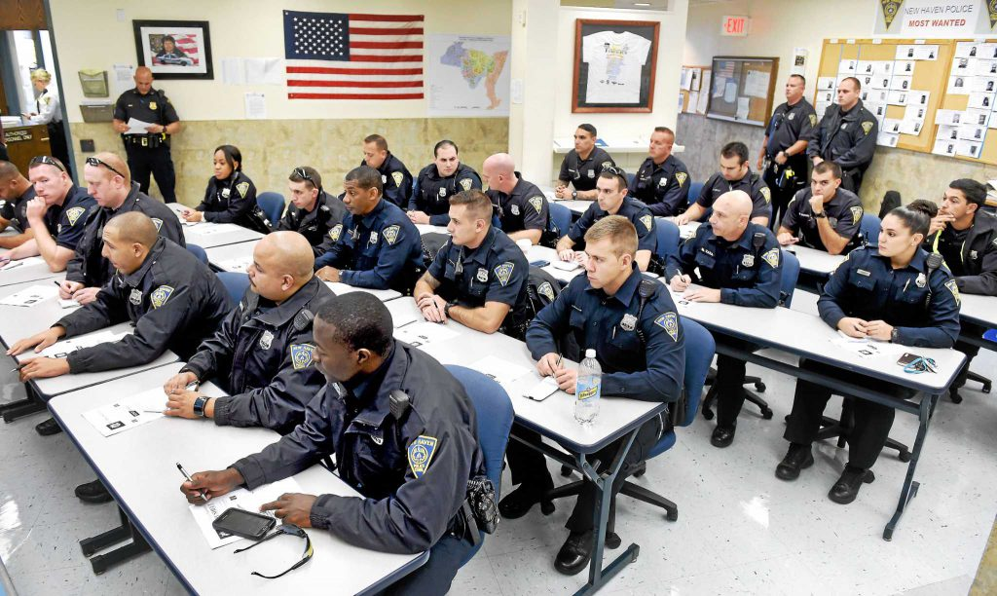
Overview
Elder Abuse In Your Community
A growing population
Older adult interactions
Recognizing abuse
Social isolation
Elder Abuse Takes Many Forms
Physical abuse
Sexual abuse
Emotional abuse
Financial abuse
Neglect

Slide 7
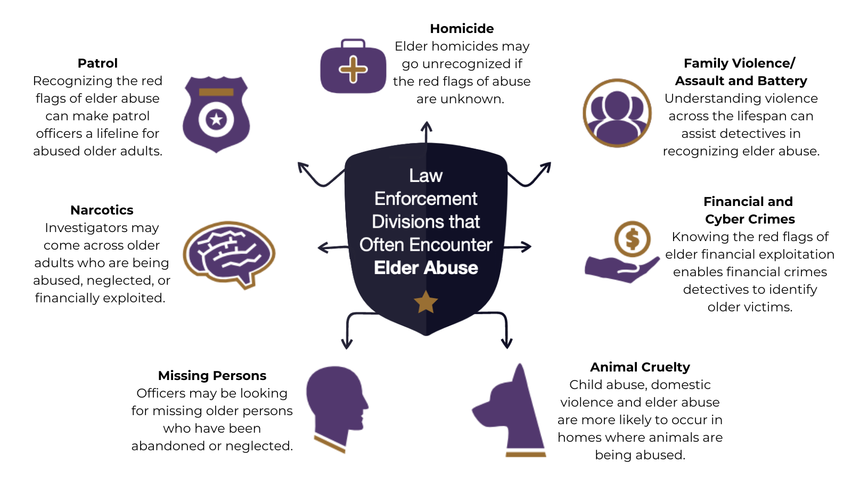
Notes:
https://www.justice.gov/file/1174026/download
Presenter:
Elder Abuse knows no boundaries and can appear in many common scenarios: Clockwise from the top
Homicide: The deaths of older adults are often discounted because "they are old" but any suspicious circumstance warrants a second look.
Family Violence: The cycle of violence in domestic situations often occurs throughout the life span of involved individuals. Understanding of the dynamics of family violence will serve you well in investigating elder abuse.
Financial and Cyber Crimes: A growing concern in the Elder Abuse fields not only within the older adult community but permeating all of our lives. Know the red flags.
Animal Cruelty: Signs of abused or neglected animals often carry over into the crime scene of abused and neglected older adults.
Missing Persons: An older adult who is reported missing may be experiencing abuse or neglect.
Narcotics: The role of prescription drugs in abuse, overmedication to sedate the older adult or the selling of an older adults prescription medication is a very prominent feature in many elder abuse cases.
Patrol: The Gateway to assistance, first responder visits can make all the difference when an officer thoroughly investigates the scene and speaks directly to the older adult

Slide 8

Have you ever encountered a situation
involving elder abuse?
When you see this symbol, you can click on the icon
to hear more about the slide
Notes:
Take 2 min
Presenter:
Stop and Think, take a moment for a knowledge check
Know your audience: It is important to have a sense of the participants experience in this area. Many people focus on one type of elder abuse, particularly financial.
This slide acts as a transition slide to build awareness of the many layered forms of abuse.
This slide will also engage participants to share their experiences with other audience members and to identify those participants who have not been called to a situation involving elder abuse.

Slide 9
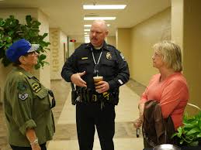
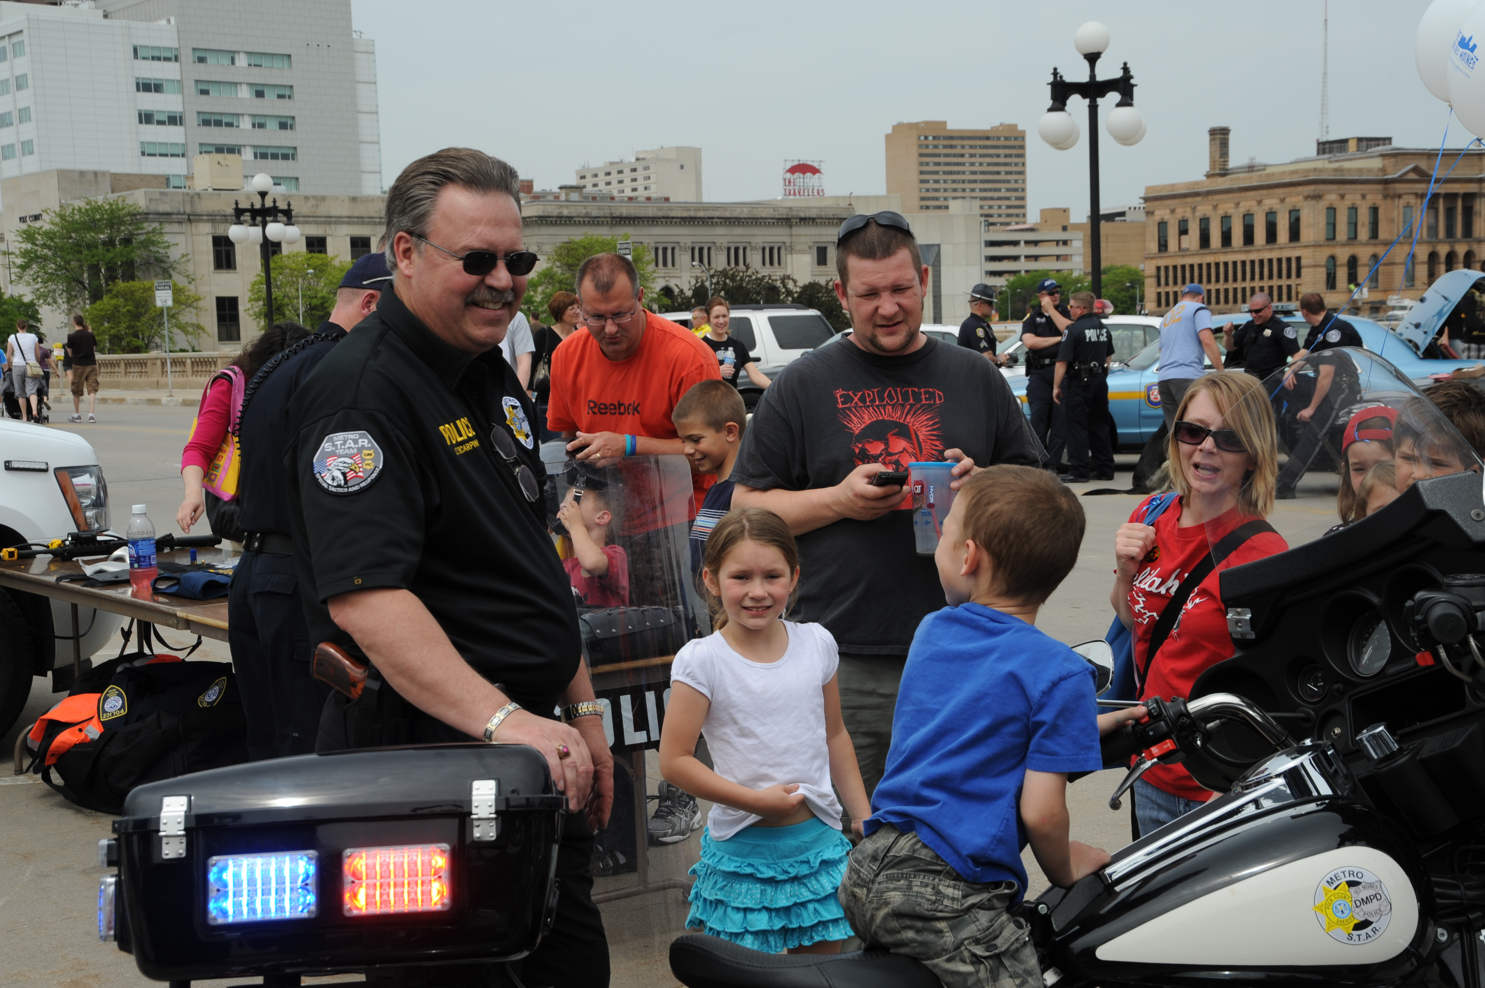
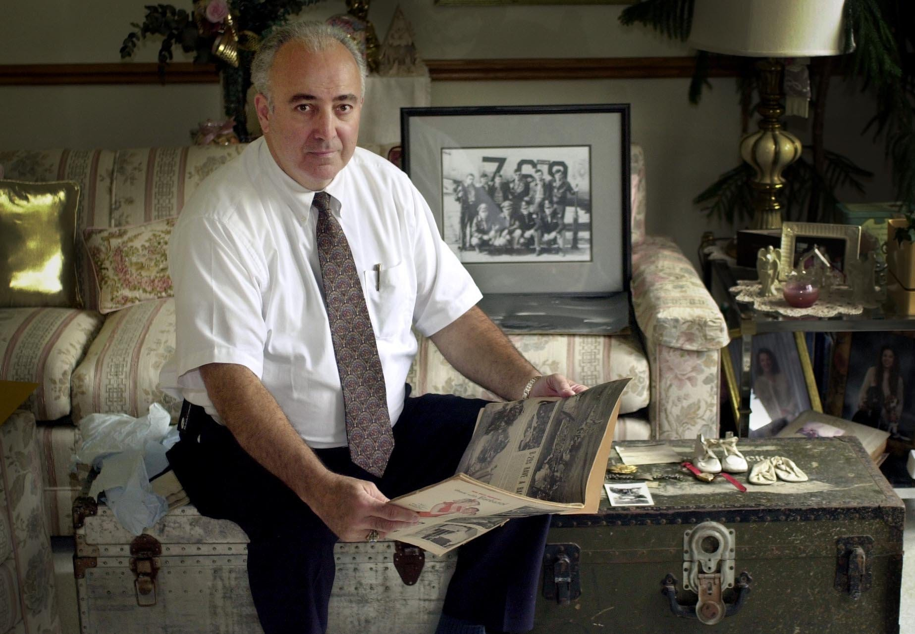
Building Trust, Building Community, Building Empathy
We all have one thing in common...
We are all aging
Treat the older adult
as you would like to be treated
Notes:
Take 2 min
Presenter:
Stop and Think, take a moment for a knowledge check
Know your audience: It is important to have a sense of the participants experience in this area. Many people focus on one type of elder abuse, particularly financial.
This slide acts as a transition slide to build awareness of the many layered forms of abuse.
This slide will also engage participants to share their experiences with other audience members and to identify those participants who have not been called to a situation involving elder abuse.

Slide 10
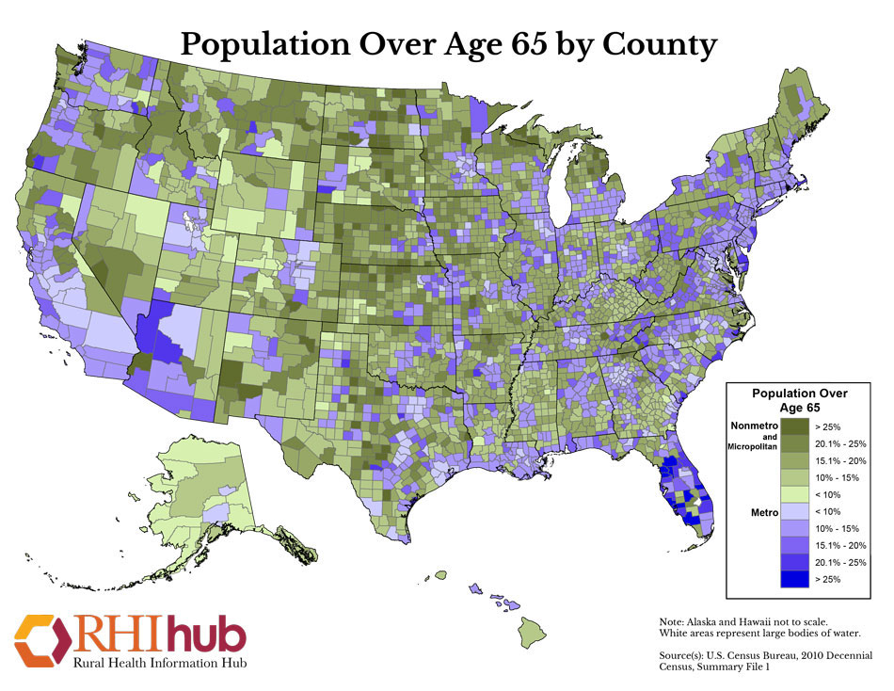
The Older Adult Population
In 2019, there were over 54.1 million ​older people in the US​.
By 2050, the population aged 65 and over is projected increase to 90 million. ​
By 2050, the percentage of people aged 65+ will represent over 21.6% of the population in the US. ​
Notes:
Presenter: Elder Abuse is growing exponentially as our population ages and in turn calls to dispatch concerning elder abuse are also growing. Law Enforcement are usually the first responders to cases of elder abuse. The abuse of older people is defined as a single or repeated act, or lack of appropriate action, occurring within any relationship where there is an expectation of trust, which causes harm or distress to an older person. This type of violence constitutes a violation of human rights and includes physical, sexual, psychological and emotional abuse; financial and material abuse; abandonment; neglect; and serious loss of dignity and respect.
Key facts
Around 1 in 6 people 60 years and older experienced some form of abuse in community settings during the past year.
Rates of abuse of older people are high in institutions such as nursing homes and long-term care facilities, with 2 in 3 staff reporting that they have committed abuse in the past year.
Rates of abuse of older people have increased during the COVID-19 pandemic.
Abuse of older people can lead to serious physical injuries and long-term psychological consequences.
Abuse of older people is predicted to increase as our country experiences a rapidly ageing populations.
This training will provide tools for prevention and protection.

Slide 11
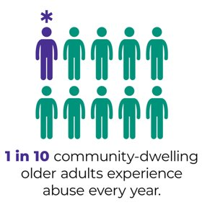
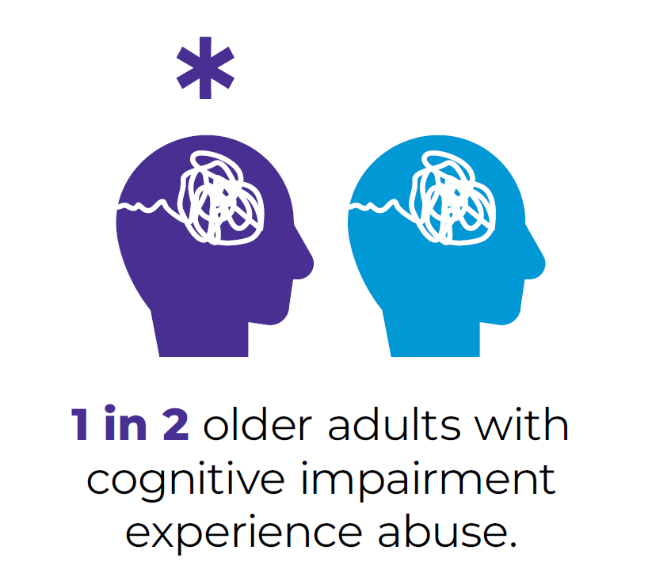
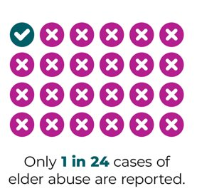
Elder Abuse IS in Your Community ...
… You just need to recognize it.
Notes:
Presenter:
Elder abuse is complex and requires keen observation skills and empathy for the older adult.
The next slides will explain why this crime is so prevalent and so underreported.

Slide 12
Training Module 2
Elder abuse risk factors
Notes:
Presenter:
This slide is to provide an overview of the training so that participants have a sense of all elements of the session.
Presenter:
This training serves as an introduction into the crime of elder abuse and all of the component parts. Financial Abuse and Physical Abuse are more familiar to LE, however, Sexual Abuse, Emotional Abuse and Neglect are very real and very serious aspects of elder abuse.
Part 2 will provide an introduction to the Elder Abuse Guide for Law Enforcement module and engaging case studies to understand how EAGLE can strengthen and support this important work

Slide 13
Recognize Risk Factors.
Recognize Abuse.
Poor Health
Disabled and dependent
Psychological Difficulties
Cognitive deficits
Financial dependence
Lower income status
Substance misuse
Anxiety and Stress
History of abuse or neglect
Limited social support
Poor relationship with perpetrator
Notes:
Presenter:
Understanding how elder abuse can happen in our communities is a first step to preventing abuse. This list provides the top reasons older adults may be susceptible to some type of abuse.
Poor Health-Chronic health conditions or poor physical health can weaken one's ability to identify signs of abuse and report it.
Disabled and dependent-When an older adult is dependent upon another for assistance, this places them in a lesser position to have control of the situation.
Psychological conditions of the older adult and also of the caregiver greatly impact the ability to perceive and/or report abuse.
Cognitive deficits-Memory loss, loss of capacity to make good decisions make it easier for an abuser to gain an advantage over an older adult
Financial dependence-If an older adult does not have the financial resources to afford care and is dependent on others provide care, they may be susceptible to abuse. Likewise, a caregiver who is receiving financial compensation for providing services, may take advantage of their access to funds.
Lower Income status-People who cannot afford different care options are limited in the types of support they can receive limiting their ability to negotiate for services.
Substance misuse-Dependency on alcohol or drugs by either party in a caregiving situation can greatly impact the dynamics of a relationship and increase susceptibility to abuse.
Anxiety and Stress-Being overwhelmed and unsure of who to trust can cause an individual to make poor decisions regarding their care.
History of abuse or neglect;-A history of previous abuse or neglect can often trigger mistrust and withdrawal from others
Limited social support-People often do not understand that there are community based resources which they can access
Poor relationship between the older adult and the perpetrator-Past abuse, or a long history of bad experiences can often perpetuate the abuse cycle.

Slide 14
Barriers Preventing Older Adults and Others From Reporting
(click each box for more information)
Older adults may experience physical decline or cognitive issues making it difficult to describe what is happening to them.
Even Physicians sometimes fail to properly identify abuse cases, attributing the elderly patient’s symptoms to their age or other medical conditions
An older adult may not have the resources to obtain an attorney to assist them.
They may also be financially dependent upon their abuser for housing and food.
If the abuser is also their caregiver, loss of such a caregiver may mean the older adult would now face an uncertain future and possibly may have to enter a long-term care facility.
Limited Financial Resources
Healthcare & Social Services
Health care workers may fear :
Losing their jobs if they report abuse
They will trigger a lengthy investigation
Supervisors won’t believe them
Communication
Dependency
A stunning reality of elder abuse cases is that the crime is often committed by a trusted other, son, daughter etc. Older adults do not necessarily want to see their family member go to jail.
Isolated people do not know that there are agencies available to assist them-
National Center on Elder Abuse, NCEA, National Elder Fraud Hotline or their local Adult Protective Services, APS Program.
Fear of Prosecution
Unaware of Options
Older adults may be reluctant to report their abuse as they fear retaliation. It is hard to report abuse by someone upon whom you are completely dependent.
An isolated individual may not identify attention from another as abusive if it is the only interaction that they have.
Fear of Retaliation
Isolation
Notes:
Presenter:
Click on each card to reveal more information. Elder Abuse is under reported due to numerous factors. If the abuser is a loved one, or primary caregiver, losing that person my increase the likelihood that the older adult may have to leave their home and lose independence. They may have an impairment which makes it difficult to communicate. They may not know they have options or where to report. Understanding these barriers brings better understanding as to why this crime is so underreported and undetected.

Slide 15

The Risk of Isolation and The Crime of Elder Abuse
Social isolation is a lack of social connections.
Older adults are at increased risk for loneliness and social isolation because they are more likely to face factors such as:
living alone
the loss of family or friends
chronic illness
hearing loss and vision loss
Notes:
Presenter:
An older adult who has been isolated from others, news and community programs may be more susceptible to abuse of all kinds.
Checking our thoughts about aging at the door and really taking a moment to get to know the person who may have experienced abuse will make all of the difference in the investigation.
National Academies of Sciences, Engineering, and Medicine. 2020. Social Isolation and Loneliness in Older Adults: Opportunities for the Health Care System. Washington, DC: The National Academies Press. https://doi.org/10.17226/25663

Slide 16
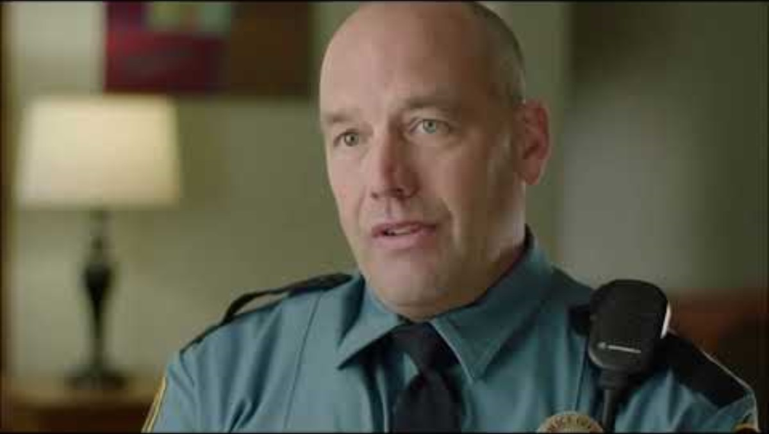
Isolation and the Crime of Elder Abuse
EAGLE Roll Call Video Clip
Notes:
Presenter:
An older adult who has been isolated from others, news and community programs may be more susceptible to abuse of all kinds.
Checking our thoughts about aging at the door and really taking a moment to get to know the person who may have experienced abuse will make all of the difference in the investigation.

Slide 17
Training Module 3
Types of elder abuse
Notes:
Presenter:
This slide is to provide an overview of the training so that participants have a sense of all elements of the session.
Presenter:
This training serves as an introduction into the crime of elder abuse and all of the component parts. Financial Abuse and Physical Abuse are more familiar to LE, however, Sexual Abuse, Emotional Abuse and Neglect are very real and very serious aspects of elder abuse.
Part 2 will provide techniques that will be helpful to LE to have meaningful conversations with older adults that will further their case and evidence collection.
Part 3 will provide an introduction to the Elder Abuse Guide for Law Enforcement module and engaging case studies to understand how EAGLE can strengthen and support this important work

Slide 18





Elder Abuse Takes Many Forms
Elder abuse, the mistreatment or harming of an older person, is an issue that we all need to prevent and address.
Elder Abuse occurs in both community and institutional settings and takes many forms, including:
Physical
Psychological & Emotional
Financial
Sexual
Neglect
Multiple forms of abuse can occur at once.
15

Slide 19

Physical Elder Abuse
EAGLE Roll Call Video Clip
Notes:
Presenter:
This is a video clip concerning physical elder abuse produced by the International Association of Chiefs of Police (IACP) and available on the EAGLE website: https://eagle.usc.edu/

Slide 20
Physical Elder Abuse
Definition
Signs & Symptoms
Questions
Physical force that results in injury or death, commonly recognized as:
Hitting
Punching
Kicking
Choking
Pinching
Slapping
Grabbing​
Twisting​
Burning​
Force-feeding​
Misuse of medications (over or under-utilization)​
Misuse of chemical or physical restraints
Notes:
Presenter:
All of this information is available on the EAGLE site https://eagle.usc.edu/types-of-abuse/physical/
This "3x5 card" format provides concise definitions, signs and relevant questions to ask to assist you in your investigation. You will see this format throughout the presentation and will be demonstrated to you on the EAGLE tour.
Having this basic awareness handy, will allow you to do your job more effectively.
Remember not all types of physical elder abuse are readily detectable. The use of medications to overly sedate an older adult may have them appearing sleepy. Depriving an older adult of necessary assistive devices such as their walker, hampers their ability to move about. These are abusive techniques utilized to control the older adult.

Slide 21
Physical Elder Abuse
Definition
Signs & Symptoms
Questions
Bruises, black eyes, welts, lacerations, and rope marks
Bone fractures, broken bones, and skull fractures
Broken eyeglasses/frames, physical signs of being subjected to punishment, and signs of being restrained
Laboratory findings of medication overdose or underutilization of prescribed drugs
Elder's report of being hit, slapped, kicked, or mistreated
Elder's sudden change in behaviour
Caregiver's refusal to allow visitors to see an elder alone

Slide 22
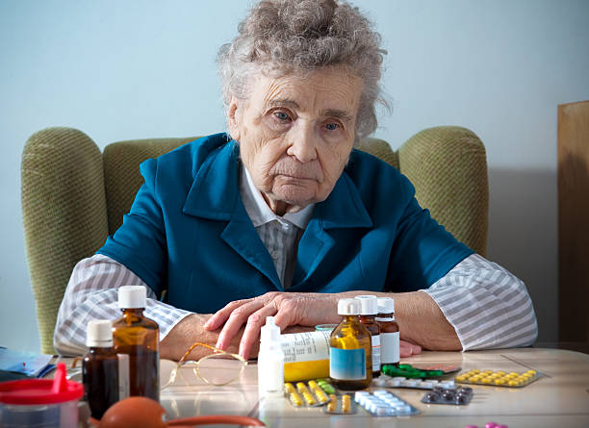
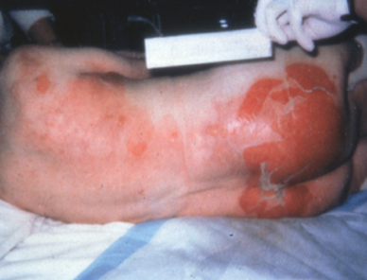
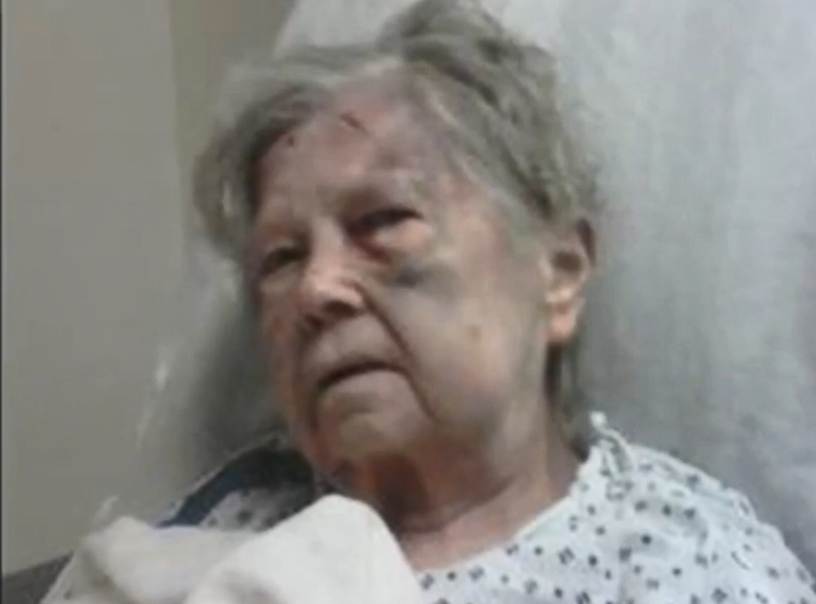
Examples of Physical Elder Abuse
Overmedication is considered a form of Elder Abuse.
Burns caused by scalding water.
Bruising on the face.
Notes:
Presenter's notes:
As defined and described in the preceding slides, Physical Elder Abuse encompasses many injuries, those that you can see and other more subtle or hidden forms. A blackeye or bruise in an unusual area should be photographed for evidence. Burns and Pressure Sores may be covered by clothing or sheets.
Overmedicating an elder so that they are "compliant" is a very common type of chemical restraint and is an all too common type of physical abuse.
Undermedicating an individual so that the caregiver can sell or use the drugs themselves is also very common.
It is important to note the medications an older adult is using. Taking photos of prescription and over the counter medications being used can be extremely helpful in building a case.

Slide 23
Physical Elder Abuse
Definition
Signs & Symptoms
Questions
Can the injuries be satisfactorily explained?
Do the explanations make sense?
How did the older adult fall?
Did the older adult trip or were they pushed?
If they fell, were any obstructions placed in their pathway?
Do they normally use an ambulatory device? Was that present when they fell? If not, where was it?
Notes:
Pro Tip! https://eagle.usc.edu/types-of-abuse/physical/
Refer to these questions to assist you in gathering information.
Having eyes on the older adult is essential.
Speaking to them alone is essential.
Listening to what the older adult tells you is also essential

Slide 24

Sexual Elder Abuse
Definition
Signs & Symptoms
Questions
The forced or unwanted sexual interaction (touching and non-touching acts) of any kind with an older adult.
Sexual abuse is also committed if sexual interaction involves an incapacitated person or one who is not competent to give informed approval.
Sexual abuse happens to older adults and dependent adults in all settings, including nursing homes, long-term care facilities, the older adult’s homes.
Notes:
Pro Tip! https://eagle.usc.edu/types-of-abuse/sexual/ disturbing video alert
Law Enforcement are very adept at handling sexual assault cases and often have specialists and/or units to assist. Sexual assault knows no age limit. Use the cues on these cards to assist you in your investigation.

Slide 25
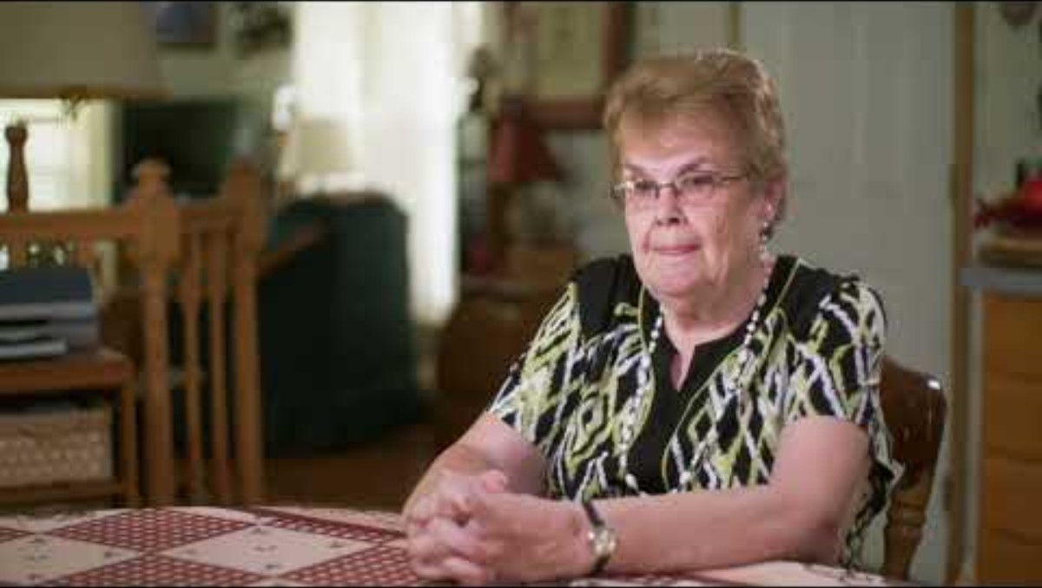
Sexual Elder Abuse
National Clearinghouse on Abuse in Later Life (NCALL) - Sexual Abuse
Notes:
Presenter:
There is often a disconnect and disbelief that sexual abuse happens to older adults. But those officers who have worked sexual abuse cases know that the sexual gratification is usually not the motive for the attack. It can come from a place of domination and control . This video clip is one of the best examples of the voice of someone who experiences a sexual abuse crime. It was produced by the National Clearinghouse on Abuse in Later Life (NCALL) NCALL has additional information concerning sexual elder abuse on their website. https://www.ncall.us/

Slide 26
Sexual Elder Abuse
Definition
Signs & Symptoms
Questions
Difficulty walking or sitting
  Fear of caregiver or others in the vicinity
  Genital or anal bleeding
  Torn or bloody undergarments
  Bruising on body, particularly in the genital area and buttocks, breasts, inner thighs
  Older adult’s statement that they have been sexually abused
Notes:
Presenter:
Signs of sexual abuse can be hidden and subtle.
Do not discount their story because you have been told they have dementia. People with dementia can often describe traumatic experiences very accurately.

Slide 27
Sexual Elder Abuse
Definition
Signs & Symptoms
Questions
Ask for details in a non-judgemental manner and using direct, short questions.
Are they physically and mentally able to resist? Able to walk? Run? Bedbound?
Do they have the capacity to consent to a sexual assault exam? If not, ask the health care power of attorney if the older adult has one.
If the abuser is not known, ask who had unsupervised access? Someone who bathed and clothed the elder?
Notes:
Presenter:
Listen carefully to what the older adult is telling you.
Building trust can make all the difference in making progress in your investigation.
Make sure questions are short and specific.
Take in the person's surroundings and photograph crime scene.

Slide 28
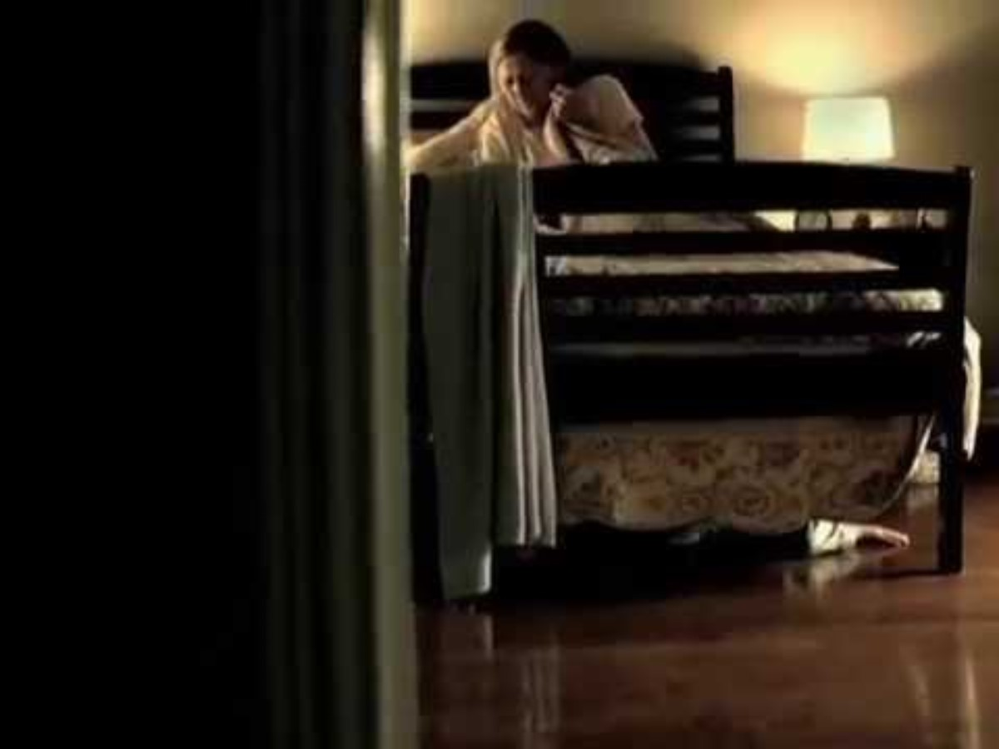
Emotional Elder Abuse
Emotional Abuse of Older Adults PSA Video by Elder Abuse Prevention Ontario
Notes:
Presenter:
This short, but effective video demonstrates the anguish and pain that emotional abuse can have on an individual. It was produced by Elder Abuse Ontario. https://eapon.ca/
We all deserve to be treated with dignity and respect.
Emotional abuse often co-occurs with other types of elder abuse.

Slide 29
Emotional Elder Abuse
Definition
Signs & Symptoms
Questions
Emotional Abuse is intentionally causing mental or emotional anguish by:
  Threatening
  Blaming
  Terrorizing
  Humiliating
  Isolating
  Demeaning
Emotional abuse usually co-exists with other types of abuse.
Notes:
Pro Tip! https://eagle.usc.edu/types-of-abuse/emotional/
Emotional Abuse can be blatant or subtle.
Reviewing the definitions, signs and interview questions provided here can help in the determination of the type and degree of emotional/psychological abuse that may be happening

Slide 30
Emotional Elder Abuse
Definition
Signs & Symptoms
Questions
Imposed isolation; communication with friends and family restricted by a caregiver
Fearful of saying or doing something wrong
Deferring to others out of fear
Nervousness around caregiver/other
Notes:
Presenter:
It is necessary to interview the older adult one-on-one away from a caregiver who may be the cause of fear, intimidation and abuse.

Slide 31
Emotional Elder Abuse
Definition
Signs & Symptoms
Questions
Does the older adult seem upset or agitated in the presence of their caregiver or family member?
Does the older adult seem fearful of saying or doing something wrong?
Is the older adult withdrawn or non-responsive in the presence of their caregiver or family member?
Does the caregiver restrict communication to friends and family?
Ask the older adult:
  Do you have family and friends?
  How often do you see them?
  How often would you like to see them?

Slide 32
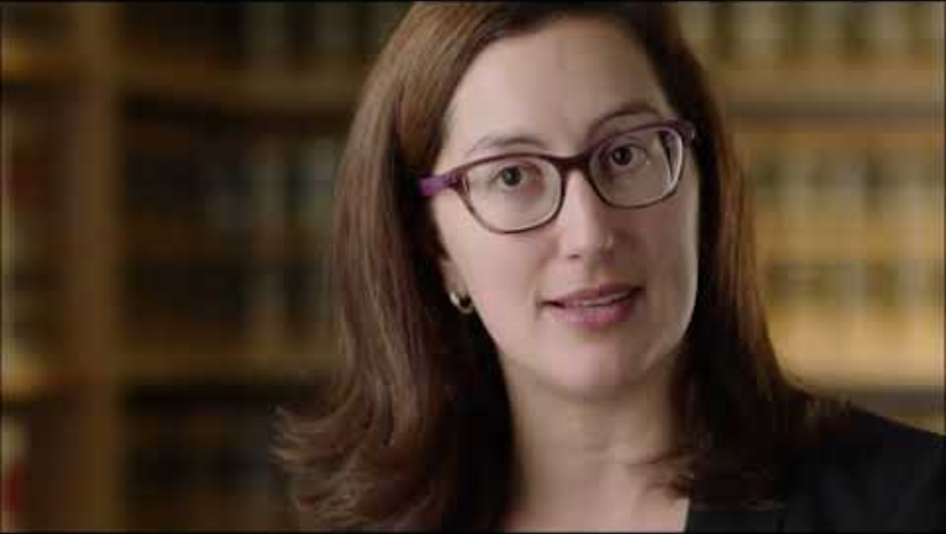
Financial Elder Abuse
EAGLE Roll Call Video Clip
Notes:
Presenter:
Elder financial abuse is a type of elder abuse in which misappropriation of financial resources or abusive use of financial control, in the context of a relationship where there is an expectation of trust, causes harm to an older person.
The Older Americans Act of 2006 defines elder financial abuse, or financial exploitation, as “the fraudulent or otherwise illegal, unauthorized, or improper act or process of an individual, including a caregiver or fiduciary, that uses the resources of an older individual for monetary or personal benefit, profit, or gain, or that results in depriving an older individual of rightful access to, or use of, benefits, resources, belongings, or assets.”

Slide 33
Financial Exploitation
Definition
Signs & Symptoms
Questions
Using an older adult’s money or assets (pension, home, social security checks) contrary to their wishes, needs or best interests, or for the abuser’s personal gain.
Undue influence is when a person of trust manipulates and takes advantage of a vulnerable elder to gain control of money, property or life—either directly or through power of attorney, trust, marriage, adoption, or inheritance.
Notes:
Pro Tip! Go to https://eagle.usc.edu/types-of-abuse/financial/
Financial Elder Abuse is a serious crime that unchecked can result in the older adult losing everything they have and left impoverished.
As a first responder, you can make all the difference by taking in the environment, photographing documents and asking just one more question.

Slide 34
Financial Exploitation
Definition
Signs & Symptoms
Questions
Sudden changes in bank account or banking practice, including an unexplained withdrawal of large sums of money by a person accompanying the elder
Inclusion of additional names on an elder's bank signature card
Abrupt changes in a will or other financial documents
Unexplained disappearance of funds or valuable possessions
Substandard care being provided or bills unpaid despite the availability of adequate financial resources
Notes:
Presenter:
Most financial elder abuse is perpetrated by a someone known to the older adult.
Other types and signs of financial elder abuse include:
fraudulent investment or insurance schemes
fraudulent contracts (such as extended car or home warranties, which in reality cover nothing)
unauthorized charges imposed by internet service providers
worthless "sweepstakes" that elderly persons must pay in order to collect winnings
fake pharmaceutical or diet/health products
medical billing scams and unnecessary medical care
predatory or unnecessary lending

Slide 35
Financial Exploitation
Definition
Signs & Symptoms
Questions
What is the older adult’s understanding of their financial situation?
Do they have a durable power of attorney? If so, can you see it? Who is named as having power of attorney for the older adult? (Take a copy or a picture!)
Is the person having power of attorney for the older adult abusing their authority?
Is the older adult’s money being used for their care?
Who pays the bills?
Notes:
Presenter:
Ascertaining the older adult’s understanding of their current financial situation, where their funds are held, who has access and if they recall the amount of money in their account(s) can also be useful.
Financial abuse tracking can be time consuming, you may wish to utilize the Senior Abuse Financial Tracking and Accounting Tool SAFTA https://www.justice.gov/elderjustice/saftatoolkit

Slide 36
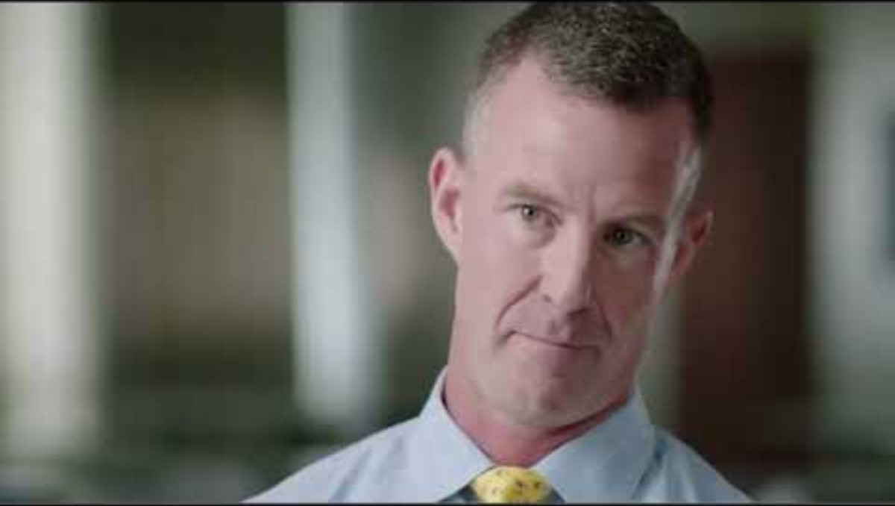
Neglect
EAGLE Roll Call Video Clip
Notes:
Presenter:
Neglect is the Number 1 form of elder abuse.
This series will address the neglect of an older adult by one in a position or duty to provide assistance.
Self-neglect will be an added chapter in upcoming additions to this training.

Slide 37
Neglect
Definition
Signs & Symptoms
Questions
The refusal or failure to fulfill any part of a person's obligations or duties to an elder. Neglect may also include failure of a person who has fiduciary responsibilities to provide care for an elder (e.g., pay for necessary home care services) or the failure on the part of an in-home service provider to provide necessary care.
The failure of an identified caregiver or responsible other to provide basic necessities, including:
Nutrition
Hygiene
Shelter
Clothing
Necessary Medical Care
Safety
Notes:
Pro Tip! Utilize this format to aid in your investigation https://eagle.usc.edu/types-of-abuse/neglect/
Observing the scene when you arrive will make all of the difference in a neglect case.
Is the outside of the property maintained?
Do you notice any bad smells, notice unsanitary conditions or hear abusive language?
All of your senses must be engaged in a neglect case.
Review these short definitions, signs and questions to assist you in collecting evidence for your case.

Slide 38
Neglect
Definition
Signs & Symptoms
Questions
Dehydration, malnutrition, untreated bed sores, and poor personal hygiene
Unattended or untreated health problems
Hazardous or unsafe living condition/arrangements (e.g., improper wiring, no heat, or no running water)
Unsanitary and unclean living conditions (e.g., dirt, fleas, lice on person, soiled bedding, fecal/urine smell, inadequate clothing)
An elder's report of being mistreated
Notes:
Presenter:
Neglect may be much more subtle then piles of trash and unhygienic living conditions.
Check the refrigerator and cupboards. Is there food in the home? Is the water drinkable? Is the plumbing functioning?

Slide 39
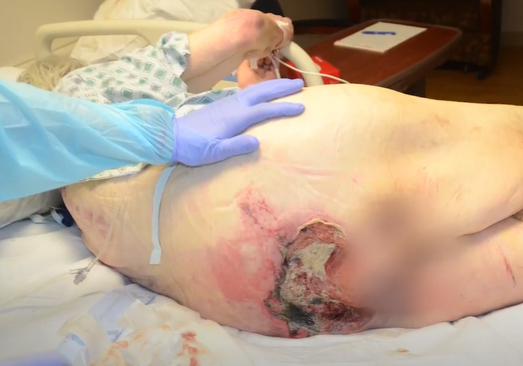
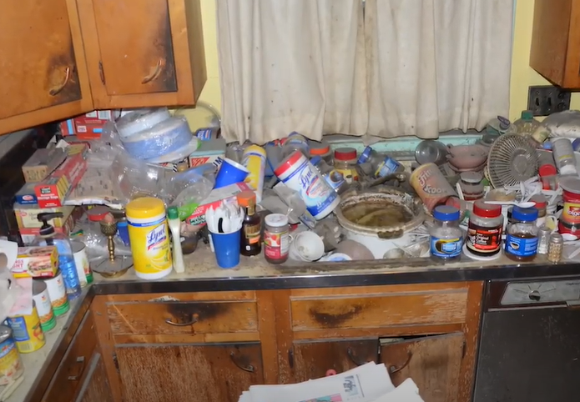
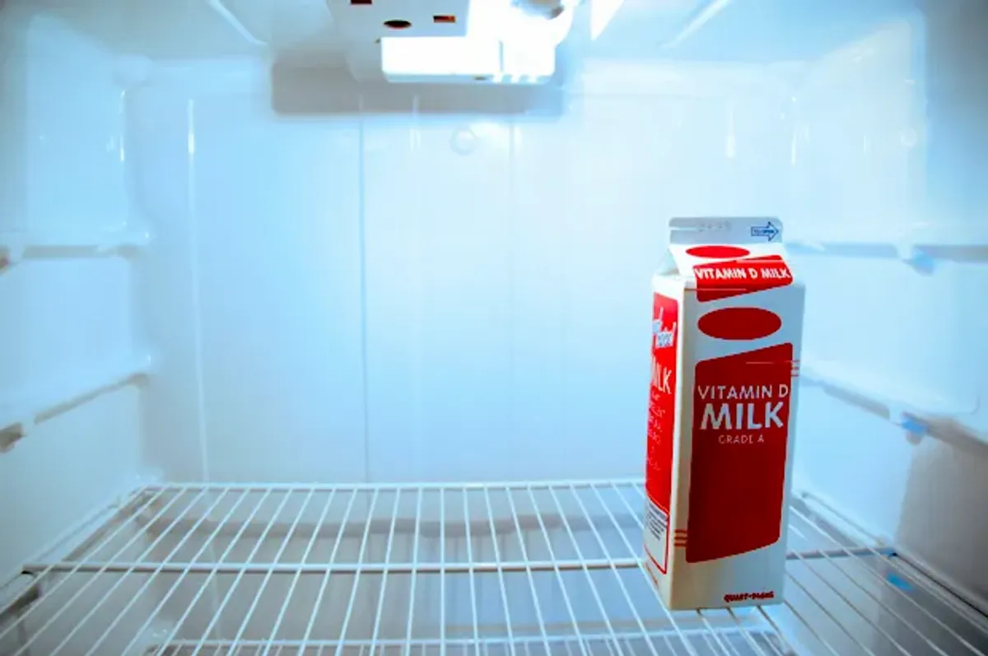
Photos Depicting Neglect
Pressure Ulcers, also known as Bed Sores
Hoarding
Empty fridge, or no edible food
Notes:
Presenter:
Pressure sores may go unnoticed.
A Bedbound person, or someone who is unable to move about freely may have skin breakdown that can evolve into infected sores.
Smells are very important in neglect cases.
Do not forget to notate what you see, hear and smell.

Slide 40
Neglect
Definition
Signs & Symptoms
Questions
Does the caregiver isolate the elder?
Are medications being taken properly? Are prescriptions current?
Is the elder eating regularly? Do they require help at mealtime?
Who pays the bills? Who cashes the social security check?
Is the caregiver compensated? How? Are they “living off” the elder?
How does the older adult’s area compare to the rest of the house (cleanliness, safety, access)?
Notes:
Presenter:
It is important to speak to the older adult alone and not rely on a family member or caregiver who may be the abuser.
Bringing Adult Protective Services into a case of neglect can be invaluable as they have great expertise into these types of elder abuse cases.

Slide 41
Training Review
Notes:
Presenter:
This slide is to provide an overview of the training so that participants have a sense of all elements of the session.
Presenter:
This training serves as an introduction into the crime of elder abuse and all of the component parts. Financial Abuse and Physical Abuse are more familiar to LE, however, Sexual Abuse, Emotional Abuse and Neglect are very real and very serious aspects of elder abuse.
Part 2 will provide techniques that will be helpful to LE to have meaningful conversations with older adults that will further their case and evidence collection.
Part 3 will provide an introduction to the Elder Abuse Guide for Law Enforcement module and engaging case studies to understand how EAGLE can strengthen and support this important work

Slide 42
Let's Review
Elder Abuse is Happening in Your Community
Elder abuse is a crime
Recognize risk factors and signs of abuse including social isolation and poor health
Elder abuse can take many forms: Physical, Financial, Emotional, Sexual, Neglect
What's Next
  Watch the video on the next slide for a summary of this section and then we will begin utilizing The Elder Abuse Guide for Law Enforcement (EAGLE) and applying it to actual elder abuse cases

Slide 43
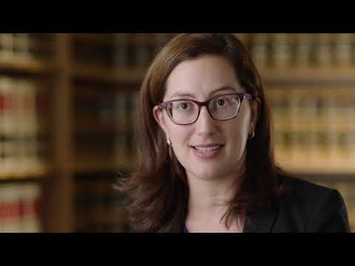
Understanding Elder Abuse
EAGLE Roll Call Video
Notes:
Presenter: It is sometimes difficult to understand how an older adult "lets" abuse occur, provides the money to scammers, will not report their physical abuse. But if we can step into the shows of the older adult, it becomes easier to understand.
A loss of vision may prevent someone from reading news updates which could provide them with information about scams.
Hearing loss may isolate someone so that they miss important information and find it difficult to participate in conversations.
Having to use a wheelchair or walker makes getting around slower and less convenient.
The loss of a driver's license makes one dependent on someone else onrpublic transportation to access medical appointments, social engagements and isolates them further.
So when the phone finally rings, a lonely person may engage with a scammer or be drawn to a stranger who gives them attention.

Slide 44
Thank you!
Notes:
Presenter:
This slide is to provide an overview of the training so that participants have a sense of all elements of the session.
Presenter:
This training serves as an introduction into the crime of elder abuse and all of the component parts. Financial Abuse and Physical Abuse are more familiar to LE, however, Sexual Abuse, Emotional Abuse and Neglect are very real and very serious aspects of elder abuse.
Part 2 will provide techniques that will be helpful to LE to have meaningful conversations with older adults that will further their case and evidence collection.
Part 3 will provide an introduction to the Elder Abuse Guide for Law Enforcement module and engaging case studies to understand how EAGLE can strengthen and support this important work

