Slide 1
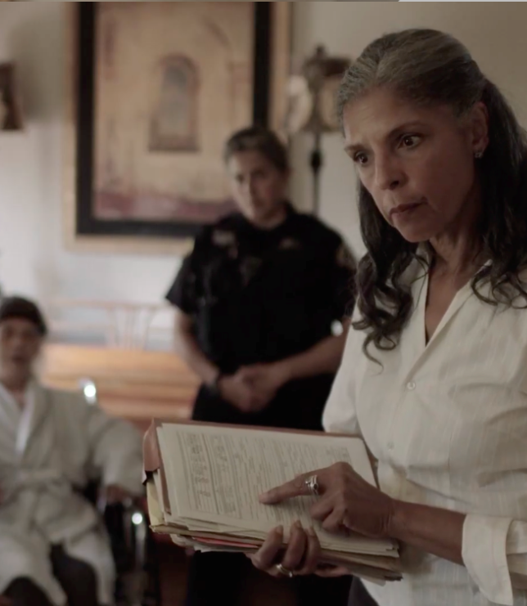
Working with a Team:
Introduction to the
Multidisciplinary Team

Slide 2
Elder Abuse Facts
Elder Abuse is Happening in Your Community
Multiple types of abuse can and often do occur at once
Recognize risk factors and signs of abuse including social isolation and poor health
EAGLE provides tools to assist in elder abuse case investigation
What's Next
Learn about Multidisciplinary Teams (MDT) and how you can collaborate with others to resolve complex cases
Every MDT has a slightly different composition and purpose
MDTs don't exist in every community

Slide 3
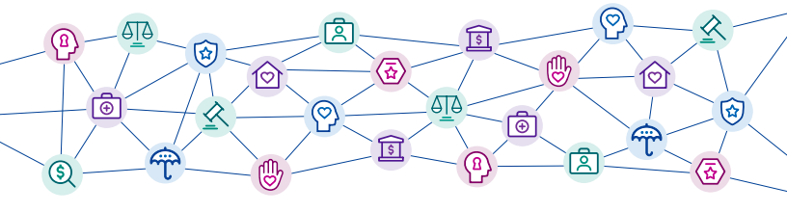
Multidisciplinary Response
Elder abuse MDTs meet regularly to discuss complicated cases of mistreatment. Professionals from different fields share their expertise to assess and address options for resolution.
Notes:
Cases are complex
Multi-layered
Require multiple experts
Multi-Disciplinary Teams (MDTs) bring together experts and community stake holders in monthly meeting to discuss cases brought from APS and the LTC Ombudsman.
Every MDT has a slightly different composition and purpose
MDTs don't exist in every community

Slide 4
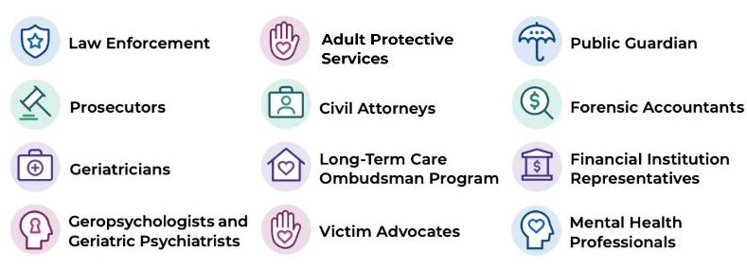
Examples of Team Members
Notes:
Examples of Multidisciplinary Team members includes: Law Enforcement, Adult Protective Services (APS), Public Guardian, Prosecutors, Civil Attorneys, Forensic Accountants, Geriatricians, Long-Term Care Ombudsman Program, Financial Institution Representatives, Geropsychologists, Geriatric Psychiatrists and other Mental Health Professionals.

Slide 5
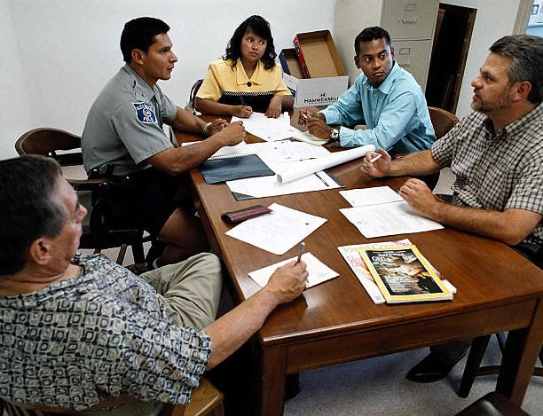
What Can MDTs Do?
Offer interdisciplinary perspectives and suggestions
Obtain financial, medical, and legal documents
Analyze documents
Conduct home visits and home inspections
Interview victims and perpetrators
Perform physical exam and/or records review for evidence of abuse or neglect
Conduct cognitive assessments
Notes:
Every Multidisciplinary Team has a slightly different composition and purpose. Generally an MDT can:
Offer interdisciplinary perspectives and suggestions
Obtain financial, medical, and legal documents
Analyze documents
Conduct home visits and home inspections
Interview victims and perpetrators
Perform physical exam and/or records review for evidence of abuse or neglect
Conduct cognitive assessments

Slide 6
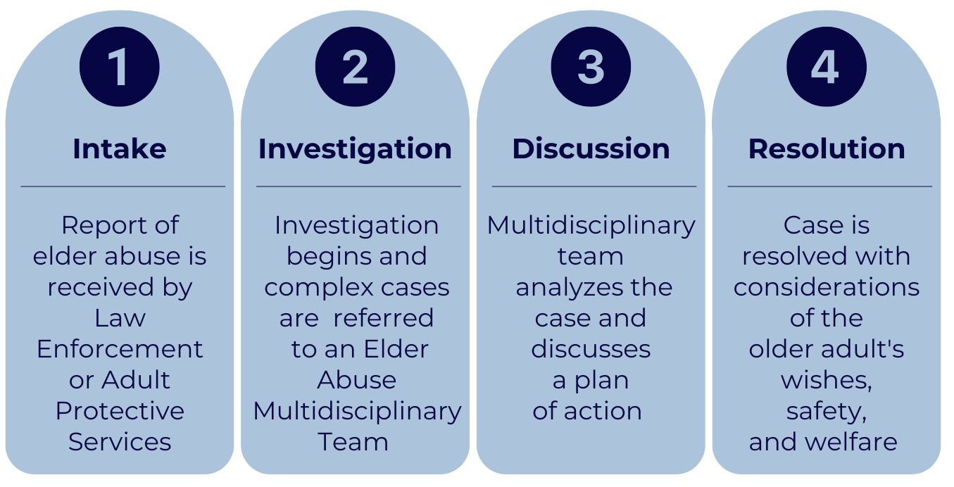
MDT Process
Notes:
The general process of case review in MDTs begins with case intake, followed by team discussion, case planning, and follow-up on any tasks that members previously committed to perform during the initial case discussion.
Report is received and investigation by law enforcement or Adult Protective Services begins
2. Complex cases are referred to a Multidisciplinary Team
3. MDT analyzes the case and discusses a plan of action
4. Case is resolved. It is important to note that case resolution may look different in every case depending on available resources.

Slide 7
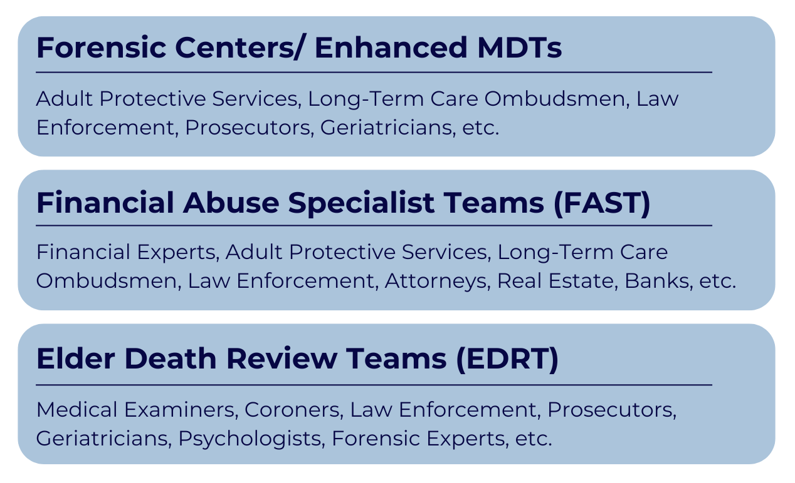
Types of MDTs
Notes:
Some MDT models have evolved to address specific kinds of abuse, such as financial abuse, or to conduct certain kinds of tasks related to abuse, such as reviewing suspicious deaths. In the U.S., the following MDT models are distinct:
• Financial Abuse Specialist Teams (FAST) – FAST teams focus on complex financial abuse cases. Teams may be comprised of public agencies only, including APS, Ombudsmen, law enforcement, the Public Guardian, or may include public-private partnerships, which include private practitioners from the fields of law, real estate, and banking.
• Elder Death Review Teams (ERDT) – EDRTs discuss cases in which abuse or neglect of an elder may have led to their death. Teams may be convened by the Medical Examiner, Coroner, prosecutor, or other public entity. Some teams meet to determine the feasibility of prosecution. Others focus only on systemic issues raised by the cases. Team membership may also include geriatricians, psychologists, and forensic experts.
• Elder Abuse Forensic Centers and Enhanced Multidisciplinary Teams (county based) -meet more than once per month and have designated staff prepare agendas and coordinate meetings, document case recommendations, assist in case plan follow-up, and track success
• Elder Abuse Coalitions/Consortia/ Task Forces – In some communities, professionals and public members interested in elder abuse issues have formed local or statewide groups to work on issues. These groups typically focus on public awareness, systems change, policy and advocacy, and education. They may also meet to conduct case review. Coalitions may be staffed by individuals from public or non-profit agencies, or they may be volunteer based

Slide 8

Adult Protective Services (APS)
Investigate allegations of elder abuse
Conduct needs assessment
Develop and implement care plan
Provide services and offer referrals
Supports older adult's rights to self-determination and autonomy
Overview of APS Investigations
Notes:
The Role Of APS
Receive reports of alleged abuse, neglect, self-neglect or financial exploitation
Assess individual’s unique needs
Develop a service plan to maintain his/her safety, health and independence
Address emergency needs for food, shelter, legal assistance or law enforcement protection
APS Will:
Honor the alleged victim’s right to make their own decisions, including declining services
Strive to keep alleged victims in their homes
Focus on the alleged victim and not the perpetrator
Consider various options for case resolution, for example, less strict alternatives to guardianship, such as supported decision making.
APS varies from state to state and from county to county. Check with your local APS program to what they can do.
Learn more about APS by visiting the National Adult Protective Services Association

Slide 9

Long-Term Care Ombudsman
Work on behalf of residents who live in Long-Term Care
Help resolve complaints in facilities
Educate residents and care providers
Advocate for quality care in facilities
Provide services and offer referrals
Overview of Long-Term Care Ombudsman
Notes:
A Long-Term Care Ombudsman:
Resolves complaints made by or for residents of long-term care facilities
Educates consumers and long-term care providers about residents' rights and good care practices
Promotes community involvement through volunteer opportunities
Provides information to the public on nursing homes and other long-term care facilities and services, residents' rights and legislative and policy issues
Advocates for residents' rights and quality care in nursing homes, personal care, residential care and other long-term care facilities
Promotes the development of citizen organizations, family councils and resident councils
Long-term care Ombudsmen efforts are summarized in the National Ombudsman Reporting System (Click here for current NORS data) to include the number of facilities visited, the types of complaints handled and the kinds of complaints filed with Ombudsmen. Data has been collected since 1996 and gives a good picture of the extent of ombudsman activities nationally and in every state.
For additional information about the long-term care ombudsman program, visit the National Consumer Voice for Quality Long-term Care.

Slide 10
Prosecutors
Advise law enforcement on criminal investigations—whether cases should be pursued and what evidence is needed
Assist law enforcement with search warrants
Review cases referred by law enforcement to determine whether charges can/should be filed
File charges and handle all aspects of a case including bail hearings, negotiations, trials, and sentencings
Work with victims and their families on charged cases
Notes:
Advise on criminal investigations—whether cases should be pursued and what evidence is needed
Assist law enforcement with search warrants
Review cases referred by law enforcement to determine whether charges can/should be filed
File charges and handle all aspects of a criminal case including bail hearings, negotiations, trials, and sentencings
Work with victims and their families on charged cases

Slide 11

Prosecutors
Chantelle Smith
Former Assistant Attorney General
Iowa Attorney General's Office

Slide 12
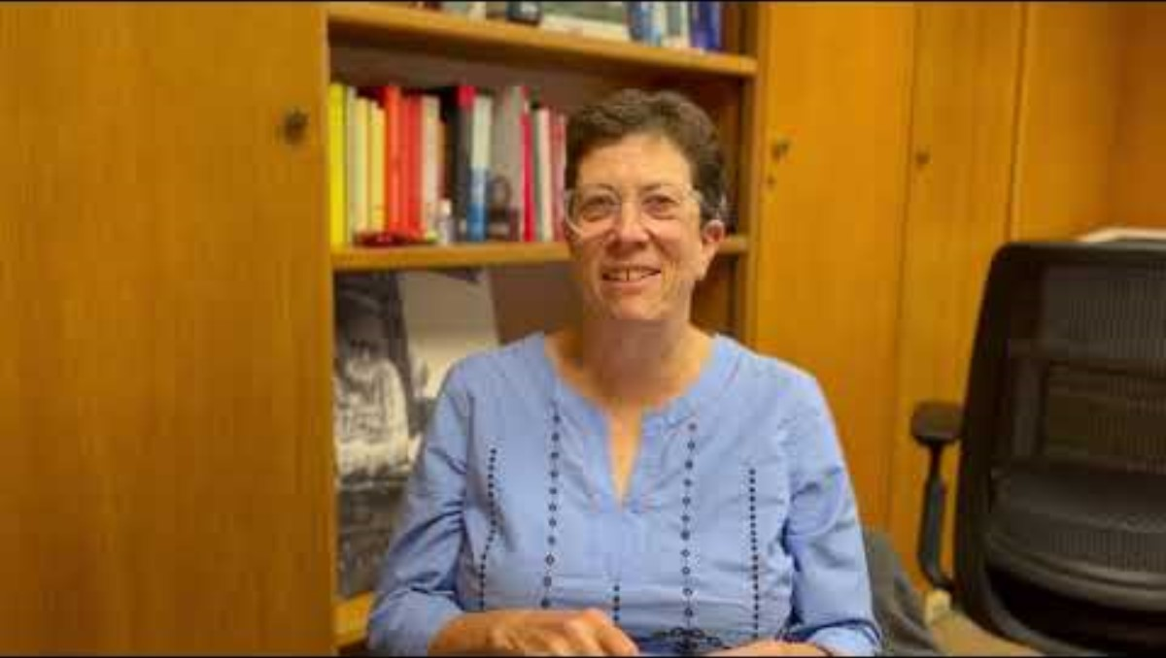
Geriatricians
Help diagnose whether elder mistreatment occurred
Perform capacity assessments
Answer questions related to medications, history, and medical conditions
Review medical charts
Recommend resources and services
Geriatrician's Role on an
Elder Abuse Multidisciplinary Team
Notes:
Consider speaking with a medical doctor for an opinion on the victim’s bruising patterns
If possible, consult with a doctor who is knowledgeable about elder abuse
Request medical records that may reveal important information about the victim’s past function and abilities
Specifically ask for the following records:
medical photos
descriptions and sizes of wounds
victim’s statements about what happened
their own opinion about the cause (if possible)
Seek a capacity evaluation by a physician or psychologist if the decision-making capacity of the victim is a question
Especially important for cases involving financial abuse or neglect
HIPAA & Law Enforcement Requests
If healthcare professionals express reluctance to share medical information due to HIPAA, refer them to:
HIPAA: A Guide for Law Enforcement (PDF)
S. Department of Health & Human Services > HIPAA > For Professionals > FAQs > When does the Privacy Rule allow covered entities to disclose protected health information to law

Slide 13
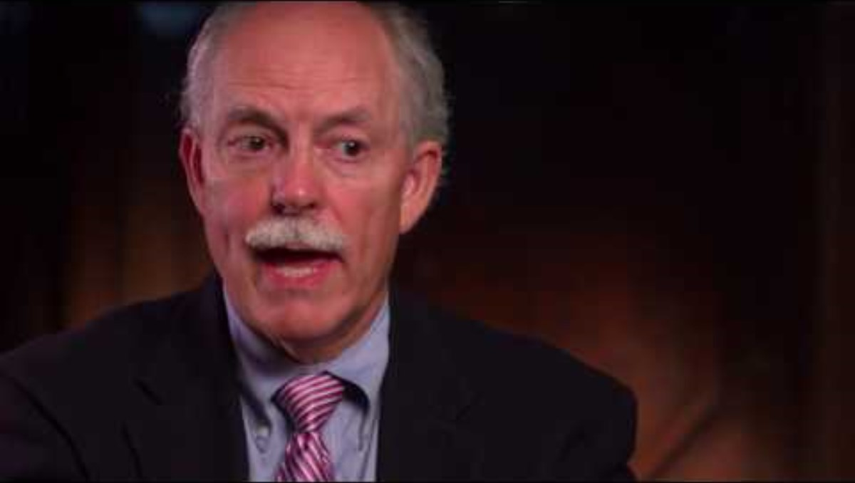
Mental Health Professionals
Conduct assessments to determine decisional capacity
Advise about mental health diagnoses
Recommend appropriate interventions
Assist in mental health crises
Cognitive Capacity Evaluators and How to Find Them
Notes:
Mental health professionals, including psychologists, psychiatrists, therapists, and social workers, may assist in examining victims, sharing mental health diagnoses and information, and providing recommendations for appropriate interventions. They can also assist by helping to stabilize a victim or perpetrator experiencing a mental health crisis and reducing potential risk or harm.
Geropsychologists and geriatric psychiatrists conduct capacity assessments to evaluate decisional capacity. Their expertise is often essential when a victim refuses assistance. Geropsychologists and geriatric psychiatrists determine if a client has capacity, namely the ability to make a decision or perform a specific task. Capacity assessments are nuanced, complex, and consequential. Clients with capacity may reject APS services, while a client who lacks capacity may not.

Slide 14

Victim Advocates
Work in the community and/or in the justice system
Advise on the criminal/ civil justice process
Accompany victims to court for emotional support
Work with older adults to preserve independence and safety
Connect victims with support services
Victim Advocates Help Victims Navigate the Justice System
Notes:
Role of an elder justice Victim Advocate
Work in the community and/or in the justice system
Advise on the criminal/ civil justice process
Accompany victims to court for emotional support
Work with older adults to preserve independence and safety
Connect victims with support services
Services are mostly provided in-person
Utilizes a person-centered model

Slide 15
Forensic Accountants
Analyze financial documents for cases in which there may be a financial motive
Advise on what additional documents are needed in an investigation/prosecution
Create spreadsheets summarizing financial documents to assist law enforcement, prosecutors, and juries in understanding complex financial crimes
Determine restitution amounts
Testify at trial to explain to the jury how the victim’s assets were obtained and spent by the defendant
Notes:
Analyze financial documents for cases in which there may be a financial motive
Advise on what additional documents are needed in an investigation/prosecution
Create spreadsheets summarizing financial documents to assist law enforcement, prosecutors, and juries in understanding complex financial crimes
Determine restitution amounts
Testify at trial to explain to the jury how the victim’s assets were obtained and spent by the defendant

Slide 16
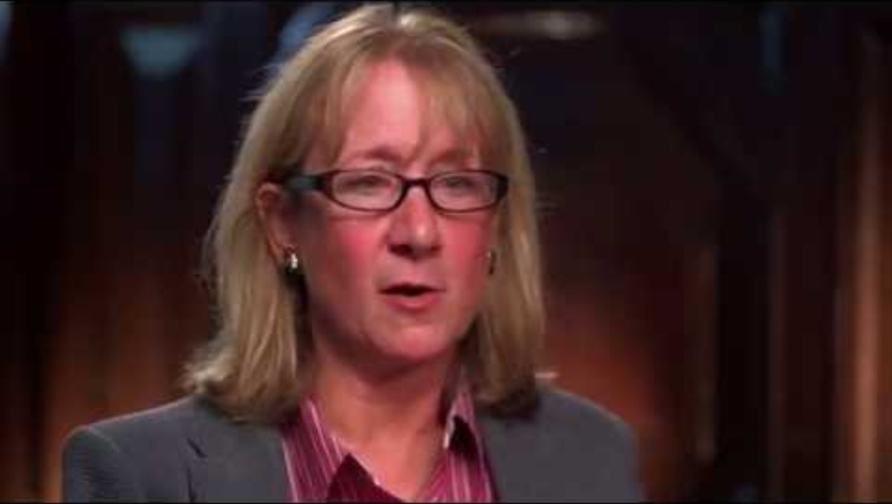
Forensic Accountants
Forensic Accountants and How to Find Them

Slide 17
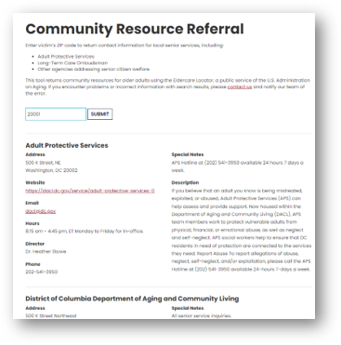
How to Find Support in Your Area
EAGLE Community Resource Referral
Enter a ZIP code to access contact information for local services, including:
Adult Protective Services
Long-Term Care Ombudsman
Other agencies addressing older adult welfare
Notes:
EAGLE Community Resource Referral- https://eagle.usc.edu/law-enforcement-resources/community-resource-referral/
In addition to EAGLE's Community Resource Referral, the DOJ Elder Justice Initiative's Elder Justice Network Locator Map may assist you in locating and collaborating with elder justice networks/ teams across the nation. - https://www.justice.gov/elderjustice/elder-justice-network-locator-map#map

Slide 18
Elder Abuse Multidisciplinary Teams
Working with a Team
Cases of elder abuse are complex and often require multidisciplinary support
Members of an MDT come together to share their expertise
Team members may include Law Enforcement, APS, Prosecutors, Health Care Practitioners, Victim Advocates, Financial Experts, and others
Notes:
Resource Guide: https://eagle.usc.edu/wp-content/uploads/2024/05/EAGLE-RESOURCE-FLYER.pdf

