Slide 1
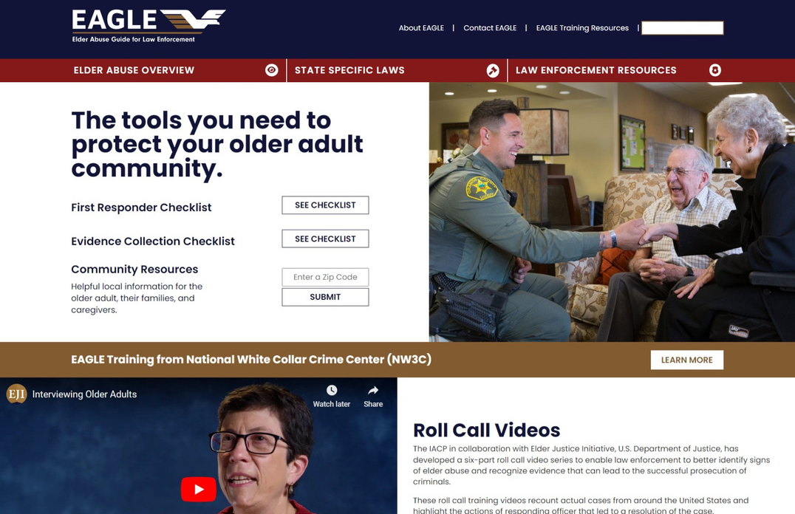
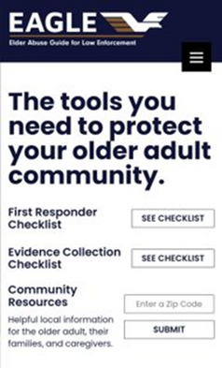
The Elder Abuse Guide for Law Enforcement
EAGLE is a FREE tool that includes resources:
State Specific Laws
First Responder's Checklist
Evidence Collection Checklist
Community Resource Referral Tool
Roll Call Videos
Elder Abuse Overview
eaglehelp@usc.edu
eagle.usc.edu
Funded by the Department of Justice.
Developed by Elder Abuse Experts at the University of Southern California.
Cross-tested by Law Enforcement Departments Across the U.S.

Slide 2
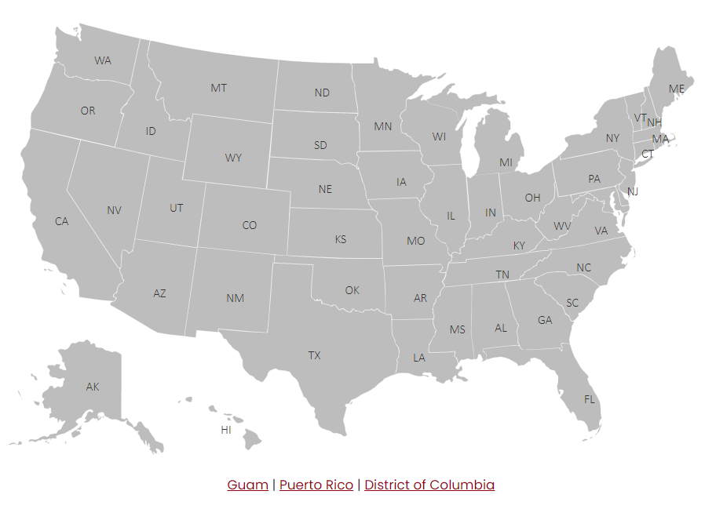
State Specific Laws Tool
Find your state's laws and statutes on elder abuse.
Visit: eagle.usc.edu
Available on:

Slide 3
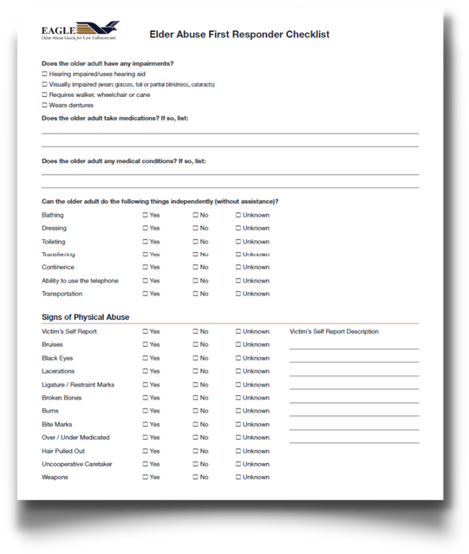
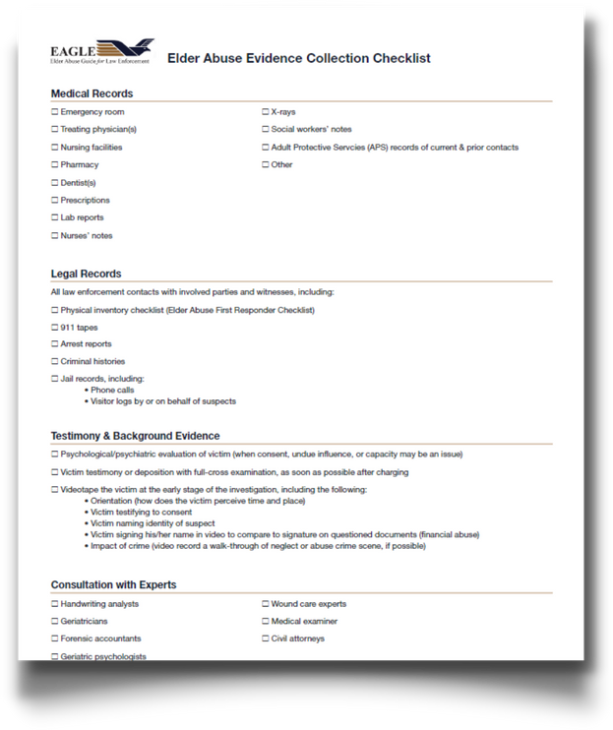
First Responder's
Checklist
Use EAGLE Checklists to Build Your Case.
Evidence Collection
Checklist
eagle.usc.edu

Slide 4
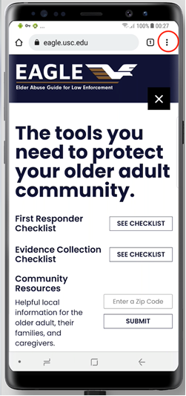
EAGLE Tools Are Mobile.
Use the Community Resource Referral Tool on the Go!
Enter a zip code and get contact information for local resources.
eagle.usc.edu

Slide 5
Elder Abuse Roll Call Videos
Learn multidisciplinary approaches to elder abuse cases!
Learn more: eagle.usc.edu/roll-call-training-videos
Roll Call Training videos developed in collaboration with IACP and the Elder Justice Initiative, U.S. Department of Justice.

Slide 6
Identify
All Types of Elder Abuse and
Take Action.
Learn more about Emotional Abuse and the other forms of Elder Abuse with our Elder Abuse Overview tools.
Visit: eagle.usc.edu

Slide 7
Elder Abuse Training Options
NW3C EAGLE Training Course
Virtual | Self- Guided
Virtual | Self-Guided
EAGLE Training on Elder Abuse
EAGLE Training on Elder Abuse
Virtual | Instructor
In-Person | Instructor
Learn more: eagle.usc.edu
IADLEST Certified | POST Varies by State

Slide 8
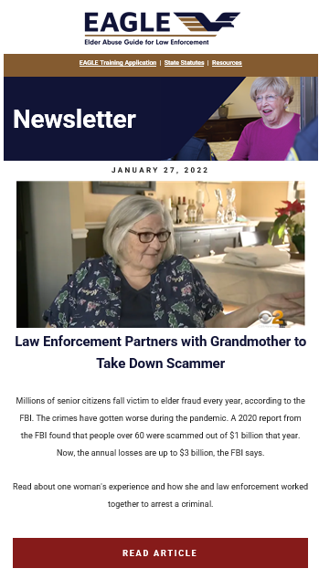
Stay Updated on News from the Field.
Sign up for the EAGLE Newsletter to receive:
Tools for law enforcement
Upcoming trainings on elder abuse
Innovations from the field
Sign up at eagle.usc.edu

