Slide 1
Strengthening Community Supports to Prevent Elder Abuse
[ PRESENTER INFORMATION]
Notes:
NOTE: This PowerPoint deck is completely customizable to you and your audience's needs. Here is a helpful link that can assist with merging this PowerPoint deck with your own PowerPoint: https://support.microsoft.com/en-us/office/reuse-import-slides-from-another-presentation-c67671cd-386b-45dd-a1b4-1e656458bb86#OfficeVersion=Web

Slide 2
Introduction: Presenter / Organization
PRESENTER BIO;
ORGANIZATION MISSION OR GOAL(S);
COMMUNITY PARTNERS, ETC.

Slide 3
Elder Abuse: What are you seeing?
When you think of elder abuse, what comes to mind?
What scenarios are you hearing about most frequently?
Notes:
NOTE: Use for in-person presentations:
Consider inserting this as a conversation starter to get the dialogue going with the audience.
Consider mentioning local or statewide statistics on elder abuse.
Remember, in addition to questions about the topic in general, we should be able to answer this question: "What community resources are available to address and prevent elder abuse?” ; "What outcomes/solutions can be offered in these situations?"
Taking a quick inventory of your efforts as well as those at the state and local levels will help you answer these questions.

Slide 4
Elder Abuse – Share 1 Thing
One thing you know about Elder Abuse
OR
One thing you want to learn about Elder Abuse
Notes:
NOTE: Use for virtual presentations:
Consider inserting this as a conversation starter to get the dialogue going with the audience.
Consider mentioning local or statewide statistics on elder abuse.
Remember, in addition to questions about the topic in general, we should be able to answer this question: What community resources are available to address and prevent elder abuse?” Taking a quick inventory of your efforts as well as those at the state and local levels will help you answer these questions.

Slide 5
What is Elder Abuse?
CDC Definition: Elder abuse is an intentional act or failure to act that causes or creates a risk of harm to an older adult. An older adult is someone age 60 or older (varies by state). The abuse often occurs at the hands of a caregiver or a person the elder trusts.
Elder Abuse occurs in both community and institutional settings and takes many forms, including:
Physical abuse
Emotional/Psychological abuse
Sexual abuse
Neglect
Financial abuse
Elder Abuse is believed to be widely under-detected and under-reported.
Notes:
**Consider state-specific definitions of an older adult, elder abuse, and mandated reporting. Verify here: https://eagle.usc.edu/state-specific-laws/
Speaker Notes:
According to the U.S. Department of Justice and the Department of Health and Human Services, 1 in 10 Americans over the age of 60 has experienced elder abuse or neglect, making it a priority social justice issue for all of us. Elder abuse affects communities on many levels, from public health to civic participation to economic resources. The costs of elder abuse are high for the affected individuals and our society. Older people’s losses can be tangible (their homes and life savings) and intangible (their dignity, independence, and possibly their lives). For society, it creates health care and legal costs, which are often shouldered by public programs like Medicare and Medicaid, and reduces older people’s participation in our communities.
Helpful Handout (Customizable): https://ncea.acl.gov/NCEA/media/STEAP-2021/Facts-About-Elder-Abuse-2021.pdf

Slide 6
What Causes Elder Abuse?
A combination of psychological, functional, social, and economic factors contribute to the occurrence of elder abuse:
social isolation
lack of access to support services and community resources
physical, mental, or emotional needs in carrying out daily activities
Elder Abuse can be prevented if we work together to create a stronger society that values and supports all of us as we age.
Notes:
Speaker Notes: Elder Abuse can happen to when we are disconnected from our communities. Without accessible, quality health and public services, our population becomes more at risk for abuse as we age. Ageism, negative stereotypes based on prejudices about age, can also drive discrimination and play a role in enabling elder abuse.

Slide 7
Elder Abuse Takes Many Forms
Elder Abuse occurs in both community and institutional settings and takes many forms, including:
Physical
Psychological & Emotional
Financial
Sexual
Neglect
Multiple forms of abuse can occur at once.
Notes:
Speaker Notes:
The following types of abuse are commonly accepted as the major categories of elder abuse. Although there are distinct types of abuse defined, it is not uncommon for an older person to experience more than one type of mistreatment at the same or different times. Signs of elder abuse can be dismissed as 'signs of aging' when in reality they can be signs of over overmedication, malnutrition, neglect, and other unattended medical needs.
Physical abuse: Use of force to threaten or physically injure an older person
Psychological/ Emotional abuse: Verbal attacks, threats, rejection, isolation, or belittling acts that cause or could cause mental anguish, pain, or distress to an older person
Financial abuse: Theft, fraud, misuse or neglect of authority, and use of undue influence as a lever to gain control over an older person’s money or property
Sexual abuse: Sexual contact that is forced, tricked, threatened, or otherwise coerced upon an older person, including anyone who is unable to grant consent
Neglect: Failure or refusal to provide for an older person’s safety, physical, or emotional needs

Slide 8
Signs of Elder Abuse
Emotional/ Behavioral Signs:
Unusual changes in behavior or sleep​​
Fearful of saying or doing something wrong
Deferring to others out of fear
Isolation from friends or family ​​
Withdrawal from normal activities ​
Notes:
Speaker Notes: Intentionally causing mental or emotional anguish by: threatening, humiliating, isolating, and demeaning to name a few. Emotional abuse usually co-exists with other types of abuse.
Signs of emotional elder abuse can include:
Nervousness around caregiver/other
Imposed isolation; communication with friends and family restricted by a caregiver
Fearful of saying or doing something wrong
Deferring to others out of fear
Helpful Handout (Customizable): https://ncea.acl.gov/NCEA/media/STEAP-2021/Signs-of-Elder-Abuse-2021.pdf
EAGLE Link: https://eagle.usc.edu/types-of-abuse/emotional/

Slide 9
Signs of Elder Abuse
Physical Signs:
Dehydration or unusual weight loss
Unexplained injuries, bruises, cuts, or sores
Unsanitary living conditions and poor hygiene
Unattended medical needs
Missing daily living aids (glasses, walker, or medications)
Torn, stained, or bloody underclothing
Sexually transmitted diseases without clear explanation
Notes:
Speaker Notes: Physical force that results in injury or death, commonly recognized as, hitting, punching, choking. Force-feeding, and misuse of medications to name a few.
Some signs can include:
Bruising
Fractures
Burns (including cigarette burns; medical equipment burns; water burns)
Hoarse voice, leaning forward to breathe, respiratory emergencies (signs of strangulation)
Pressure sores, AKA bedsores
Choking on food, or pneumonia resulting from food in lungs (signs of force-feeding)
Misuse of medications (for example: unfilled or expired prescriptions; over-administering, such as sedatives; stealing opiates)
EAGLE Link: https://eagle.usc.edu/types-of-abuse/physical/#1497371751242-57c277bc-b8d9

Slide 10
Signs of Elder Abuse
Financial Signs:
Unusual or sudden changes in spending patterns, will, or other financial documents
Fraudulent signatures on financial documents
Unpaid bills
Changes of trusts, wills, deeds for the benefit of the abuser
Inappropriate financial reimbursement for services to the older adult victim
Caregiver “living off” the older adult
Notes:
Speaker Notes: Financial exploitation of an older adult is defined as using an older adult’s money or assets (pension, home, social security checks) contrary to their wishes, needs or best interests, or for the abuser’s personal gain. Undue influence is often used for financial abuse. Undue influence is when a person of trust manipulates and takes advantage of a vulnerable elder to gain control of money, property or life—either directly or through power of attorney, trust, marriage, adoption, or inheritance.
Signs of financial elder abuse can include:
Changes of trusts, wills, deeds for the benefit of the abuser
Large purchases for the abuser’s benefit
Inappropriate financial reimbursement for services to the older adult victim
Caregiver “living off” the older adult
EAGLE Link: https://eagle.usc.edu/types-of-abuse/financial/#1497371132826-8b64b176-2934

Slide 11
Signs of Elder Abuse
Sexual Abuse:
Bruising on body, particularly in the genital area and buttocks, breasts, inner thighs
Difficulty walking or sitting
Fear of caregiver or others in the vicinity
Genital or anal bleeding
Torn or bloody undergarments
Notes:
Speaker Notes: Sexual Elder Abuse is the forced or unwanted sexual interaction (touching and non-touching acts) of any kind with an older adult. Sexual abuse is also committed if sexual interaction involves an incapacitated person or one who is not competent to give informed approval. Sexual abuse happens to older adults and dependent adults in all settings, including nursing homes, long-term care facilities, the victims’ homes.
Signs of sexual abuse can include:
Bruising on body, particularly in the genital area and buttocks, breasts, inner thighs
Difficulty walking or sitting
Fear of caregiver or others in the vicinity
Genital or anal bleeding
Torn or bloody undergarments
EAGLE Link: https://eagle.usc.edu/types-of-abuse/sexual/#1499986431993-deeef387-150c

Slide 12
Signs of Elder Abuse
Neglect Signs:
Lack of medical aids (glasses, teeth, hearing aid, medications)
Lack of assistive medical devices (wheelchairs, walkers, scooters, canes)
An unsupervised person with dementia
A bed-bound person left without care
Medical orders not followed, including administration of medications
Delay in seeking care for injuries or medical conditions, including bedsores
Unchanged diapers or lack of incontinence supplies
Notes:
Speaker Notes: Elder Neglect is the failure of an identified caregiver or responsible other to provide basic necessities, including: nutrition, hygiene, shelter, clothing, necessary medical care, safety
Signs of neglect can include:
Lack of medical aids (glasses, teeth, hearing aid, medications)
Lack of assistive medical devices (wheelchairs, walkers, scooters, canes)
An unsupervised person with dementia
A bed-bound person left without care
Medical orders not followed, including administration of medications
Delay in seeking care for injuries or medical conditions, including bedsores
Unchanged diapers or lack of incontinence supplies
EAGLE Link: https://eagle.usc.edu/types-of-abuse/neglect/#1497371407096-9c84f436-fcaf

Slide 13
Self-Neglect
Definition: Behavior of an older person that threatens their own health or safety due to physical or mental impairment or other causal conditions.
Self-neglect is the most common condition handled by Adult Protective Services (APS).
Examples:
Hoarding
Malnutrition
Unsanitary living conditions
Living without electricity, water
Inability to perform self-care tasks
Notes:
Speaker Notes: Elder self-neglect is associated with increased risk for elder abuse in a community-dwelling population.

Slide 14
Reporting Abuse
If suspected abuse or neglect is occurring, connect to a local or state reporting number.
Community Settings | Long-Term Care Facilities
Adult Protective Services [Insert Local APS Number] | Long-Term Care Ombudsman [Insert Local LTCOP Number]
For emergencies, call 9-1-1.​
Notes:
Speaker Notes:
You do not need to prove that abuse is occurring; it is up to professionals to investigate allegations of abuse. Making a report in instances of suspected abuse or neglect is the right thing to do, and it’s easy.
Reporting Abuse:
Programs such as Adult Protective Services (APS) and the Long-Term Care Ombudsman Program are here to help. Report suspected abuse in the community to the local Adult Protective Services agency, and report suspected abuse in a nursing home or long-term care facility to the local Long-Term Care Ombudsman Program. For serious and immediate emergencies, call 9-1-1.
For reporting numbers outside of your area:
If the elder lives in another state, call the protective services agency where the elder lives. To connect to a local or state reporting number, use the EAGLE Community Resource Referral tool or contact Eldercare Locator at eldercare.acl.gov or at 1-800-677-1116 M-F 9AM – 8PM ET
EAGLE Tool: https://eagle.usc.edu/law-enforcement-resources/community-resource-referral/

Slide 15
5 Things Everyone Can Do
to Prevent Elder Abuse
Listen to older people and caregivers to understand their challenges and provide support.
Educate one another about the signs of abuse.
Report suspected abuse or neglect as soon as possible.
Build a community that fosters social connections and supports.
Reach out to professional services for support where available.
Notes:
Speaker Notes:
The strongest communities are those in which everyone has the chance to contribute and nobody lives in isolation. When strong social supports are not in place to keep us connected as we age, it becomes difficult to prevent, notice, and report abuse. It is up to all of us to build strong supports for one another and prevent abuse before it happens.
Here are several important things WE can do to prevent elder abuse:
Listen to older people and caregivers to understand their challenges and provide support
Educate one another about the signs of abuse and how to get help; report abuse or suspected abuse as soon as possible
Build a community that fosters social connections and supports
Use professional services for support where available
Reach out for support from local health and social services
Helpful Handout (Customizable): https://ncea.acl.gov/NCEA/media/STEAP-2021/5-Things-Everyone-Can-Do-to-Prevent-Elder-Abuse-2021.pdf

Slide 16
Resource Slides
Notes:
NOTE: You can use this space to discuss other resources you think would be helpful to your audience. The following resource slides are optional.

Slide 17
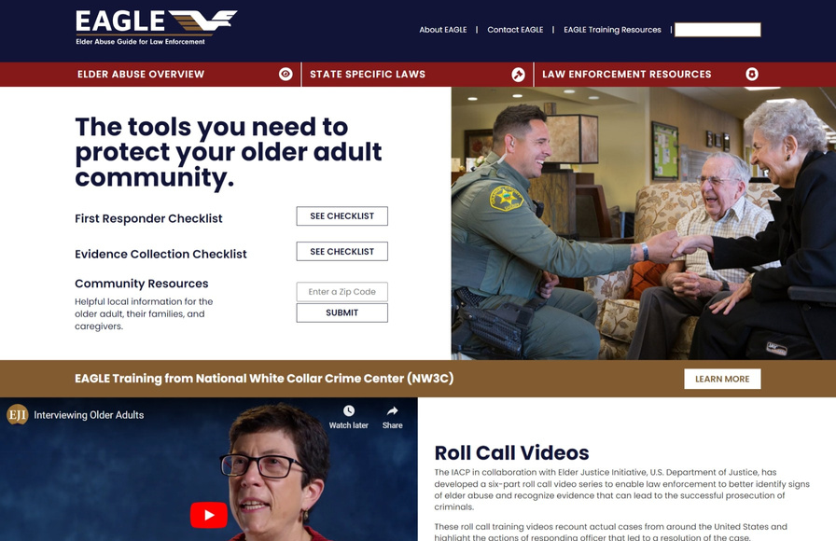
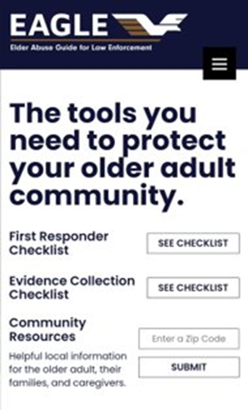
The Elder Abuse Guide for Law Enforcement
The Elder Abuse Guide for Law Enforcement
EAGLE is a FREE tool that includes resources like:
State Specific Laws - Your state's penal codes & statutes on elder abuse.
First Responder's Checklist - Document the signs of abuse, fillable online and as a pdf. No data is saved.
Evidence Collection Checklist - Keep evidence organized. Created with prosecutor insight. Great for MDTs.
Community Resource Referral Tool- Enter a zip code for local information on resources
Training Opportunities - IADLEST certified & POST available
Roll Call Videos - Based off real-life cases of elder abuse
Elder Abuse Overview - Covers seven types of abuse, questions to consider & actions to take
Visit: eagle.usc.edu
Funded by the Department of Justice.
Developed by Elder Abuse Experts at the University of Southern California.
Cross-tested by Law Enforcement Departments Across the U.S.
Notes:
Speaker Notes: The Elder Abuse Guide for Law Enforcement (EAGLE) provides a comprehensive platform of trainings, instructional videos, and best practice tips for APS, law enforcement, and adult services professionals. EAGLE supports providers across agencies to identify, intervene, and resolve cases of elder abuse. Tools are versatile, and can be utilized by community members as well as advocates who are interested in learning more on law enforcement approaches to elder abuse.
EAGLE Site Link: https://eagle.usc.edu/
NOTE: Please reach out if you want additional slides specifically on EAGLE, or if you have any EAGLE questions. eaglehelp@usc.edu

Slide 18
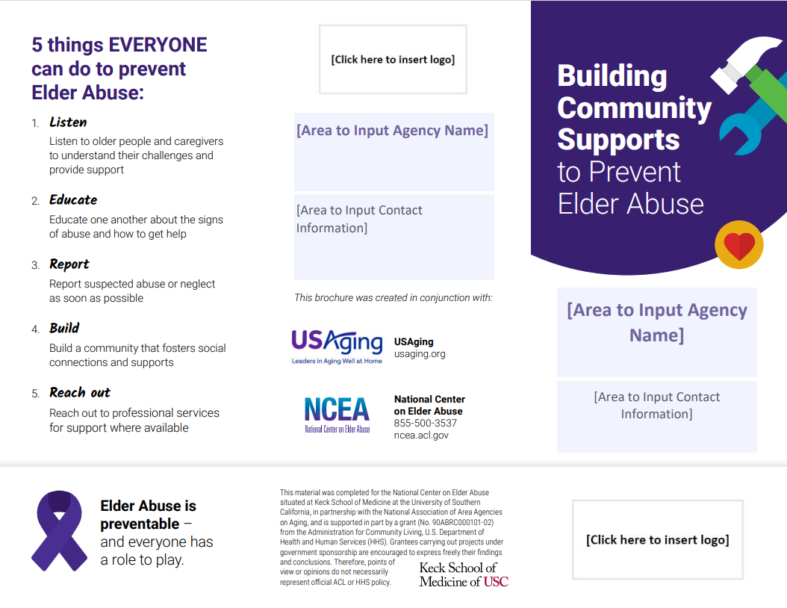
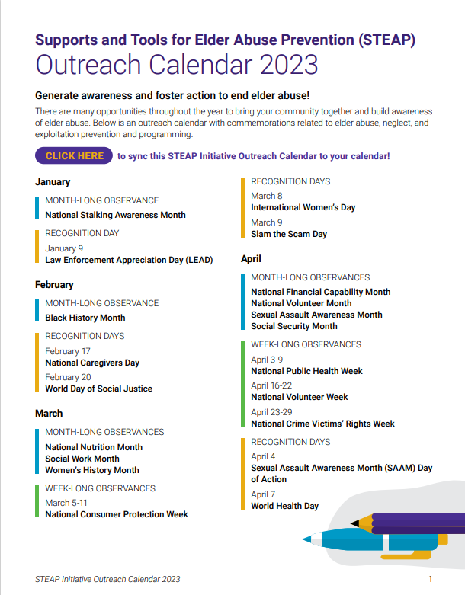
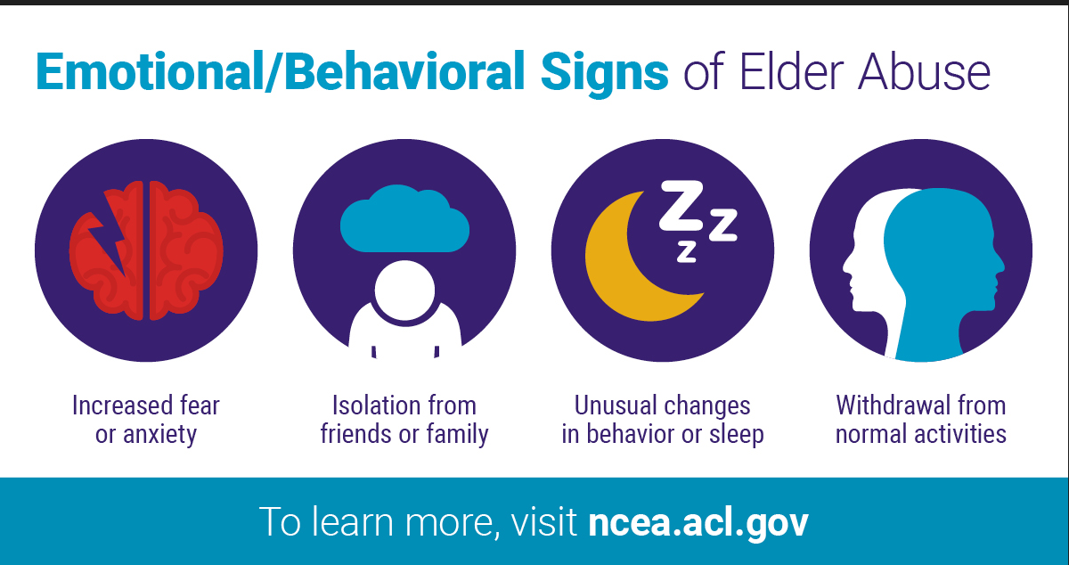
Customizable & Ready-to-Use Outreach Tools
Outreach Calendar for Year-Round
Elder Abuse Prevention Programming
Fact sheets and Brochure
Presentation Template and Social Media Graphics
bit.ly/STEAPtk
Notes:
Speaker Notes: The STEAP Initiative was launched by the National Center on Elder Abuse (NCEA), in partnership with the USAging, in an effort to educate and empower communities to create a sturdy structure of support to notice, report, and prevent abuse. The centerpiece of this Initiative is a toolkit with practical and customizable elder abuse education and outreach resources,
Full list of STEAP Resources:
https://ncea.acl.gov/Resources/STEAP.aspx

Slide 19
Thank You! Q&A
Connect With Us
[ Organization Name ]
[ Phone Number ]
[ Address ]
[ Hours of Operation ]
[ Website ]
[social media handle]
[social media handle]
[social media handle]
[social media handle]
[social media handle]
Notes:
NOTE: Consider mentioning others in your community who helped make the training possible. For example, did someone donate food for the training or did someone provide the training space at no charge? Encourage presentation attendees to connect with your agency and share about services/programs offered.
Speaker Notes: Thank you for attending this presentation. We hope you enjoyed it and found the information and resources valuable. Please tell us your thoughts on this presentation by completing this short survey (survey instructions in the Presentation Evaluation Form).
Helpful Handouts (Customizable):
1. Informative Brochure: https://ncea.acl.gov/NCEA/media/STEAP-2021/Building-Community-Supports-to-Prevent-Elder-Abuse-2022.pdf
2. Presentation Evaluation Form: https://ncea.acl.gov/NCEA/media/STEAP-2021/Presentation-Evaluation-Form-2021.pdf

