Slide 1
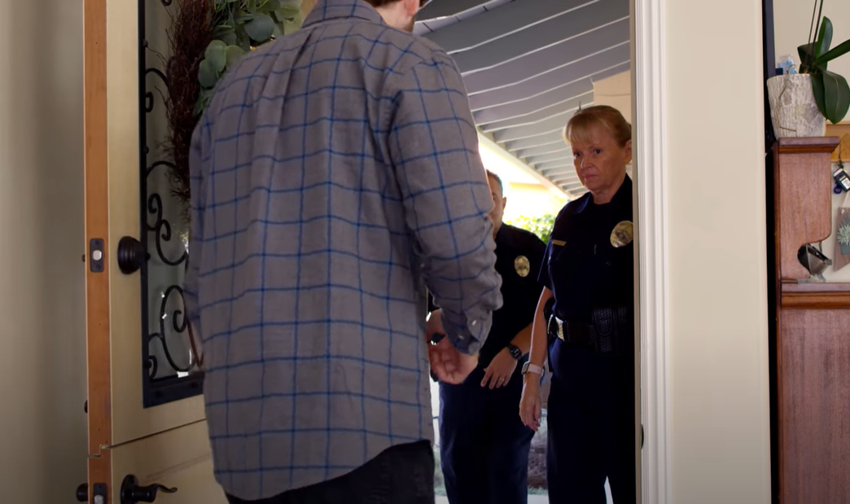
Introducing EAGLE:
A tool for professionals investigating cases of Elder Abuse

Slide 2
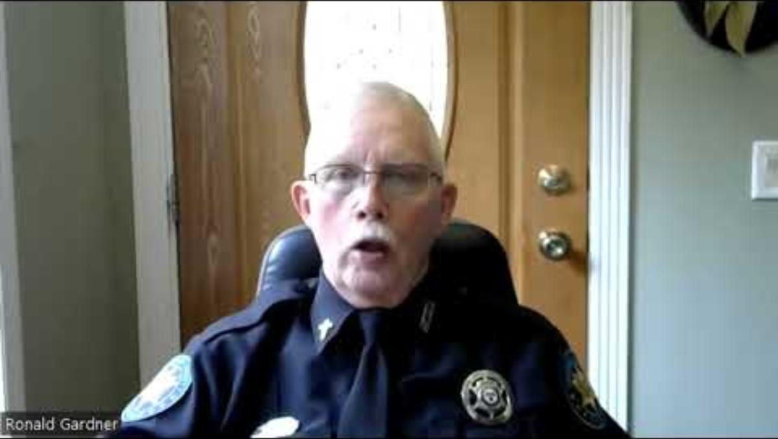
Welcome to EAGLE
Deputy Ron Gardner
Harrison County Sherriff's Department
Gulfport, Mississippi
Notes:
We want to thank you for your time and attention to this important subject matter. Many LE across the country have discovered EAGLE and have provided us with guidance and positive feedback.
It is our goal to support you as you delve into this complex area.

Slide 3
Elder Abuse Facts
Elder Abuse is Happening in Your Community
The types of elder abuse include Physical, Psychological/ Emotional, Financial, Sexual, and Neglect
As the population of older adults increases, so too will the number of elder abuse cases
What's Next
Learn about the tools available on The Elder Abuse Guide for Law Enforcement
"EAGLE is as important as your badge in your arsenal of tools"
Deputy Ron Gardner MS

Slide 4

EAGLE Intro
Development
Tools & Capabilities
EAGLE is a FREE tool that helps officers effectively identify and investigate potential Elder Abuse cases.
Funded by the Department of Justice (DOJ)
Developed by elder abuse experts at the University of Southern California (USC)
Cross tested by law enforcement departments across the country!
Notes:
EAGLE is funded by the Department of Justice (DOJ) and was developed at the University of Southern California (USC). EAGLE is cross-tested by law enforcement, making it by law enforcement, for law enforcement!

Slide 5
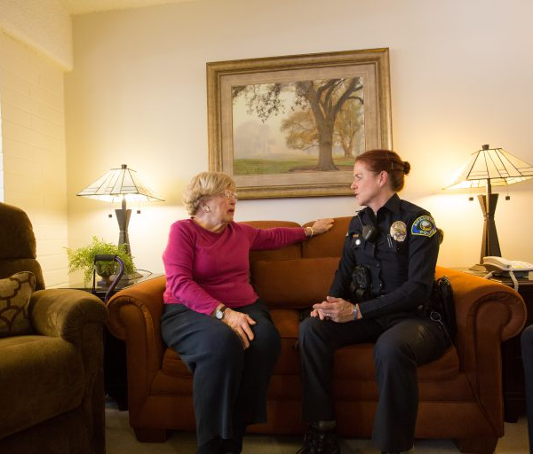
EAGLE Intro
Development
Tools & Capabilities
Quick reference Elder Abuse 101
Versatile Elder Abuse identification, documentation, and investigation tools
ZIP-code-based community resources locator
State Specific Laws on Elder Abuse
Roll Call Videos based on real life Elder Abuse cases
Notes:
Here are some key tools available on the EAGLE site.
There is an elder abuse overview of six types of elder abuse, providing the definitions, signs, questions to consider, and actions to take if you encounter these calls.
There are also two types of checklists that assist in identifying and documenting signs of elder abuse: The First Responder's Checklist and Evidence Collection Checklist, which are covered in the site tour video.
The Community Resource Referral Tool is powered by ElderCare Locator, which gives local resources when you enter a zip code.
The State Specific Laws provide state penal codes and statutes on elder abuse. Information varies by state.
There are also roll call videos that range from 7-10 minutes and provide demonstrations of how law enforcement approached real-life cases of elder abuse.

Slide 6
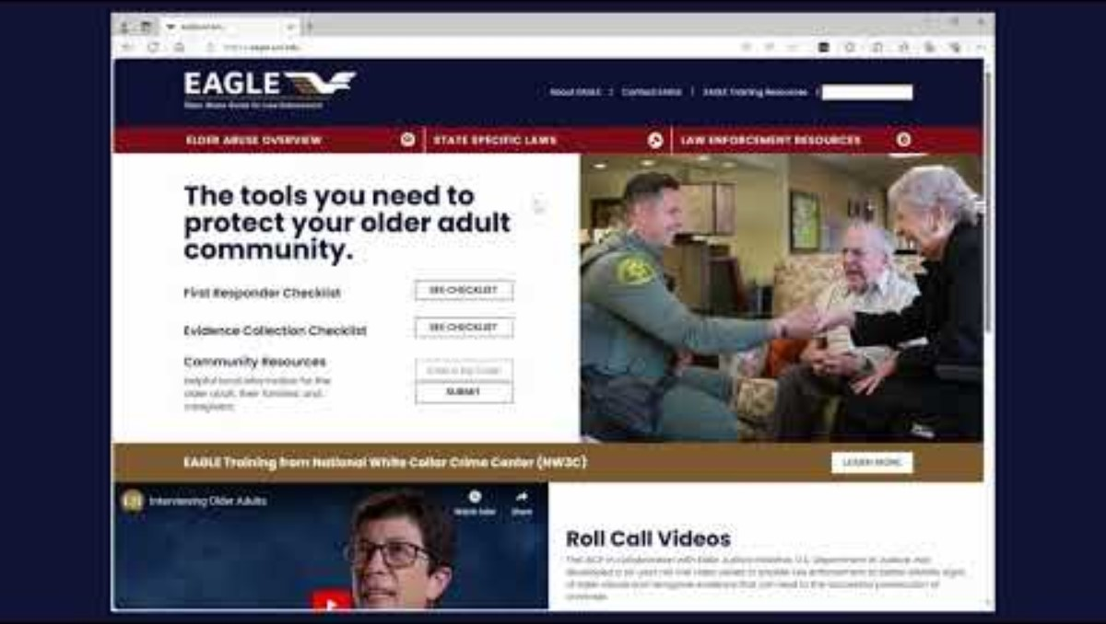
EAGLE Site Tour
Notes:
Website: eagle.usc.edu
This video is a brief walkthrough of the EAGLE site and its key resources. (10 min)

Slide 7

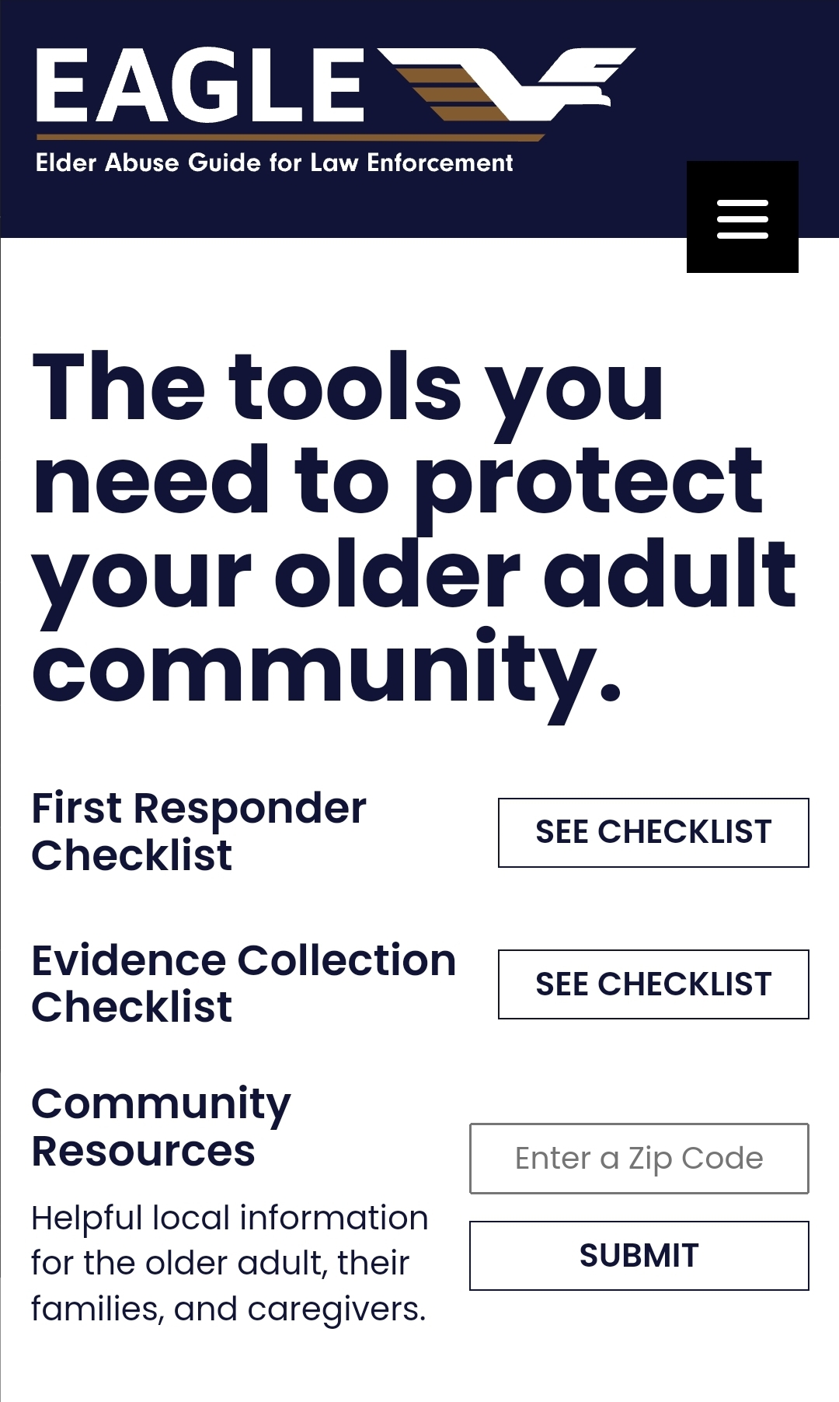
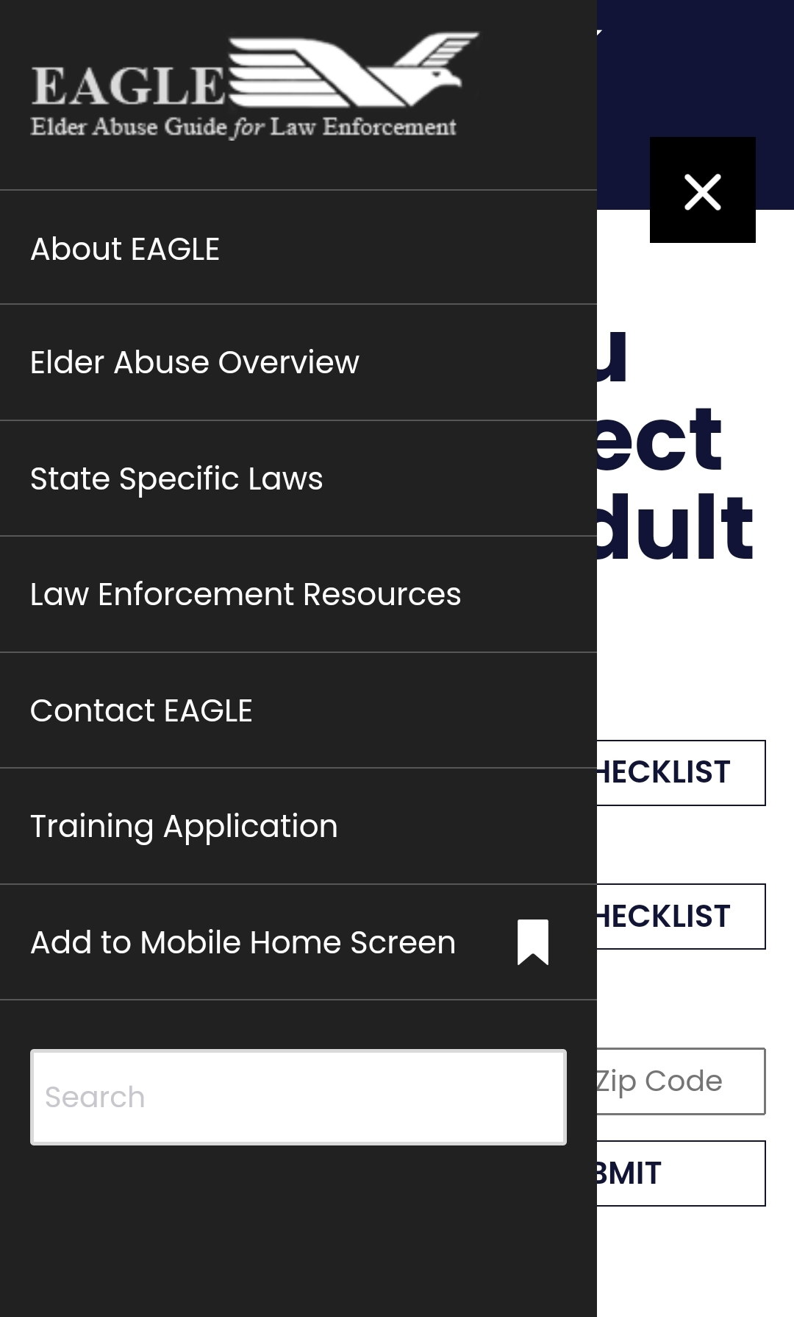

Mobile Friendly
Use it in the Field
EAGLE on Mobile Device
Pin to your cell phone
Visit EAGLE on your mobile at eagle.usc.edu
Select the three-lined icon in the top right, this will populate the drop-down menu
Once you have the drop-down menu, select “Add to Mobile Home Screen”
Notes:
EAGLE is mobile friendly and easy to use in the field.
Here are some instructions on how you can pin it to your mobile device's homepage for ease of access.
If this method does not work, there is a demo on how to make an EAGLE shortcut on the following slide.

Slide 8
EAGLE Tools
Key Takeaways
Access EAGLE in the field on your mobile device, or in the office via desktop at eagle.usc.edu
EAGLE is a FREE tool and has key resources to add to your toolkit:
  State Specific Laws - Your state's penal codes & statutes on elder abuse.
  First Responder's Checklist - Document the signs of abuse, fillable online and as a pdf. No data is saved.
  Evidence Collection Checklist - Keep evidence organized. Created with prosecutor insight. Great for MDTs.
  Community Resource Referral Tool - Enter a zip code for local information on resources
  Training Opportunities - IADLEST certified & POST available
  Roll Call Videos - Based off real-life cases of elder abuse
  Elder Abuse Overview - Covers seven types of abuse, questions to consider & actions to take
Notes:
Here are some key take aways from this EAGLE introduction.

Slide 9
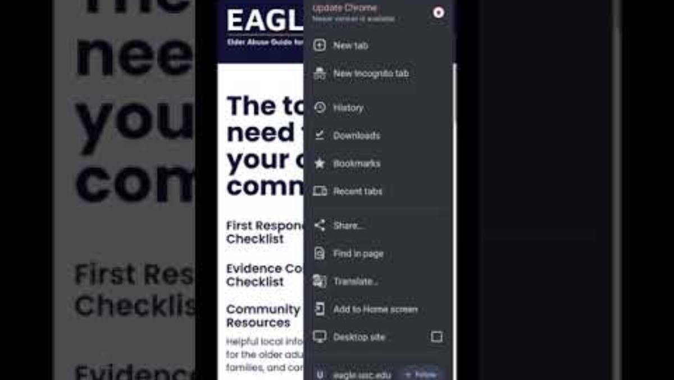
Pin to Mobile Demo
If the previous method did not work on your device, go to your main browser's menu and create an EAGLE shortcut.
Notes:
The photo/screenshot is blurry to me (and I could
not get this to work either)

Slide 10
Let's Review
Elder Abuse is Happening in Your Community
Cases of elder abuse are complex
EAGLE provides tools to assist in identifying, intervening, and resolving cases of elder abuse
Reach out to experts in your community to assist in complex cases
What's Next
Apply your knowledge of elder abuse and the Elder Abuse Guide for Law Enforcement to real cases
  Conduct Interviews
  Investigate Suspicions
  Build Your Case

Slide 11

Case Studies:
Using EAGLE in cases of elder abuse

Slide 12

Case Studies Demo

Slide 13
Case Study 1
Mrs. Smith: 78-year-old female
Neighbors called reporting Mrs. Smith was outside on the curb near her home. She is disoriented and dressed only in dirty undergarments.

Slide 14
Initial Interviews
(click each box for more information)
Mrs. Smith is a widow who lives with her daughter.
Screams and crying can be heard coming from the house a couple times a week.
Mrs. Smith has dementia.
EAGLE Resource
Do’s and Don’ts of Memory Loss
Daughter works during the day and Mrs. Smith stays alone in the home.
Daughter states Mrs. Smith gets upset when she tries to bathe and dress her mother.
Daughter attributes Mrs. Smith's bruises to a recent fall.
The home has bad odors including the smell of feces and urine.
EAGLE Resource
Recognizing Abusers
Mrs. Smith says she was out on the curb because she is “tired of being locked in her room everyday”.
She complains of a pain on her heels when she lies down.
During the interview, you notice some bruising on her face, neck, and arms.
Mrs. Smith’s bed has soiled sheets
EAGLE Resource:
Interviewing Older Adults
First Responder Checklist
Neighbor
Daughter
Mrs. Smith
Notes:
Interview Neighbor
New Information: You learn Mrs. Smith is a widow who lives in the home with her daughter. Occasionally screams and crying can be heard coming from the house, particularly during the day. Mrs. Smith has dementia.
EAGLE Resource:
A diagnosis of Dementia does not mean that person is an unreliable source of information. Know that people with memory problems can tell you what happened – especially if an event made an emotional impact. When interviewing an older adult with Dementia or a related condition, remember the Do’s and Don’ts of Memory Loss.
Interview Daughter
New Information: Daughter works during the day and Mrs. Smith stays alone in the home. Daughter claims she tries to bathe and dress her mother, but Mrs. Smith gets upset when she tries to do so. Daughter attributes Mrs. Smith's bruises to a recent fall. While interviewing the daughter inside the home, there is a clear fecal, urine, and stale odor.
EAGLE Resource: Most elder abuse is perpetrated by a family member, caregiver, or anyone providing care, including professionals. Learn more about general traits and characteristics of abusers with EAGLE’s Recognizing Abusers.
Interview Mrs. Smith
New Information: Mrs. Smith claims she was out on the curb because she is “tired of being locked in her room everyday”. She complains of a pain on her buttocks when she lies down or sits. Also during the interview, you notice some bruising on her face, neck, and arms. On inspection of her room, all that is present is a bed with soiled sheets and a wooden chair.
EAGLE Resource: EAGLE outlines some helpful tips to consider when Interviewing Older Adults including how to overcome ageism, suggestions for which type of questions to ask, and tips on the right time and place to interview.
At this point, the First Responder Checklist can be used to help you take note of and document important details of the case. The checklist asks important questions about the older adult, as well as the home environment. The tool lists the various signs of abuse for you to consider if you suspect elder abuse. The checklist can be filled out online and sent to you via email (no information is ever saved by EAGLE) or printed out. Locate the First Responder Checklist on EAGLE and fill it out with the information you have so far.

Slide 15
Abuse Present
(click each box for more information)
If you are suspicious for one type of abuse, consider ALL types of abuse
Emotional Abuse
Financial Abuse
Neglect
Physical Abuse
Sexual Abuse
EAGLE Resource:
Elder Abuse Overview
Clearly document all suspicions of abuse
Observations
Narrative
Photographs
EAGLE Resource:
Elder Abuse Photography Tips
Learn About The Types of Abuse
Document Abuse
Notes:
Learn about the Types of Elder Abuse
You suspect abuse may be occurring but are unsure of how to classify it. If the situation is suspicious for one type of abuse, consider ALL types of abuse. Learn more about each type, the common signs, questions to ask yourself if you suspect abuse, as well as actions to take if a particular type of abuse is occurring. Make sure to clearly document all suspicions.
Types of Abuse
Document Suspected Abuse
You are suspicious abuse is occurring and must now properly document your suspicions. In addition to writing everything you observe in your narrative, photographs are an excellent form of documentation. EAGLE’s Elder Abuse Photography Tips outline what to photograph, including injuries, medications, and home environment, and how to measure injuries through photographs such as noting time and date and including a measuring tool or size reference in each photograph. This resource also presents tips on getting shots from different perspectives and tips on lighting in photographs.

Slide 16
Investigate Suspicious Wounds
(click each box for more information)
With permission, Mrs. Smith allows you to inspect the painful area on her heels.
You note a red wound, possibly a bed sore.
Consult with a medical professional to verify your suspicions.
EAGLE Resource:
Documenting Bed Sores
Taking a closer look at Mrs. Smith, you notice bruising on her face, neck, and arms.
You are suspicious these bruises all came from one fall, as the daughter claimed.
You determine they may not be due to an accident.
EAGLE Resource:
Bruising Identification Chart
Skin Wound
Bruises
Notes:
Investigate Suspected Bed Sores
With permission, Mrs. Smith allows you to inspect the painful area on her buttocks. You note a large red wound, possible a bed sore. Consult with a medical professional to verify your suspicions.
EAGLE Resource:
Bed sores, also known as pressure ulcers, can be a sign of elder neglect if left untreated. Use the Documenting Bed Sores resource to learn more about bed sores, where to look for bed sores, the stages of bed sores, and why it is important to document bed sores.
Investigate Suspected Bruising
Taking a closer look at Mrs. Smith, you notice bruising on her face, neck, and arms. You are suspicious these bruises all came from one fall, as the daughter claimed. You determine they may be intentional bruises, not accidental.
EAGLE Resource:
While it may be true that older adults can bruise more easily, it is important not to simply disregard bruises or automatically attribute them to falls. Ask the older adult about any bruises they may have, gently and in private. 90% of older adults with bruises who have been physically abused can tell you how they got their bruises, and this includes many older adults with memory problems and dementia. Use the Bruising Identification Chart to help you discern between accidental bruising and intentional bruising.

Slide 17
Working with Others to Build a Case
(click each box for more information)
The doctor in the emergency department is reluctant to provide any information
The doctor conducts a medical assessment
Mrs. Smith has a Stage II Pressure Sore and bruising inconsistent with a fall
EAGLE Resource:
HIPAA: A Guide for Law Enforcement
APS had been called out to the same residence on a report of abuse of Mr. Smith who subsequently died.
No further action was taken at the time but you want more information about what had happened.
EAGLE Resource:
Find contact information for APS in your area using: Community Resource Referral
APS and Law Enforcement: Partners in Prevention
The prosecutor thanks you for being so thorough in your documentation and collection of evidence.
They plan to bring charges against the daughter.
EAGLE Resource:
Evidence Collection Checklist
State Specific Laws
Adult Protective Services
Doctor
Prosecutor
Notes:
Working with Others to Build a Case
New Information: The doctor in the emergency department conducts a medical assessment and confirms Mrs. Smith has a Stage III Bed Sore and bruising inconsistent with a fall.
EAGLE Resource:
Consider speaking with a medical doctor for an opinion on the victim’s condition. To learn more about the victim’s past function and abilities, request medical records such as medical photos, descriptions and sizes of wounds, victim statements, and medical opinions. Seek a capacity assessment by a physician or psychologist if decision-making capacity is a concern. If possible, consult with a doctor who is knowledgeable about elder abuse.
If healthcare professionals express reluctance to share medical information due to HIPAA, refer them to HIPAA: A Guide for Law Enforcement.
Adult Protective Services
New Information: APS had previously been called out to Mrs. Smith’s residence on a report of abuse of Mrs. Smith’s husband by their daughter. Shortly after, Mr. Smith passed away and due to a lack of evidence, no further action was taken at the time.
EAGLE Resource: Adult Protective Services (APS) responds to reports of abuse, neglect, or financial exploitation. As a result, you will often work side-by-side with APS. When law enforcement and APS collaborate, they may develop stronger relationships, more effective communication about cases, a better understanding of each’s role, and more efficient and effective case resolution. Use the Community Resource Referral to find the Adult Protective Services Agency in your area. Enter your Zip Code to populate a list of resources, including APS, in your area. The Community Resource Referral is a great tool to share with older adults, families, and caregivers.
Learn more about how APS can be your Partner in Responding.
Prosecutor
New Information: The prosecutor thanks you for being so thorough in your documentation and collection of evidence. They will use it all in their case. The prosecutor also discloses they will bring charges against the daughter.
EAGLE Resource: Prosecutors are essential to resolving cases of elder abuse. As a result, it is important to work closely with them to build your case. Confer with the prosecutor during early stages of the investigation. Use the Elder Abuse Evidence Collection Checklist to help you gather crucial pieces of the case. The Evidence Collection Checklists prompts you to gather medical records, financial records, legal records, testimony & background evidence, and physical evidence.
Each case of elder abuse is complex and deals with various penal codes, charges, and statutes. Using the State Specific Laws resource, select your state for a list of all the elder abuse related laws that may come into play in your case.

Slide 18
Elder Abuse Knowledge
(click each box for more information)
Additional Training
NW3C Training- online training offered by National White Collar Crime Center (NW3C)
EAGLE Training- in-person or virtual training offered by the EAGLE Team
Additional EAGLE Resources
EAGLE Roll-Call Videos
Community Engagement Toolkit
National Resources
EAGLE Newsletter.
Would Like to Learn More
Confident in Knowledge
Notes:
Would Like to Learn More About Elder Abuse
Use EAGLE as a free resource. If you would like further training on elder abuse in-general or even on a specific topic, EAGLE offers other training options:
NW3C Training- EAGLE has collaborated with the National White Collar Crime Center (NW3C) to create a free online training covering the features of EAGLE and the types of elder abuse, with a focus on financial elder abuse.
In-Person Training- The EAGLE team can also perform in-person or virtual training at no cost to your organization. The training can cover elder abuse broadly or go into a specific topic.
Confident in Knowledge About Elder Abuse
Having taken this training course, you are now confident in your ability to respond to elder abuse cases. Use the EAGLE Roll-Call Videos as a reference if you come across similar cases.
Go out into your communities and share the information you have learned through community engagement. To assist in outreach and training efforts, EAGLE has created materials for you to download and customize for social media and community presentations on elder abuse. National resources such as the National Elder Fraud Hotline, the National Association of Adult Protective Services, domestic violence centers, and the National Center on Elder Abuse (NCEA) are available for assistance and guidance.
To stay in the loop about the latest in elder abuse, sign-up for the EAGLE Newsletter.

Slide 19

Real-Life Case: Neglect

Slide 20
Case Study 2
Law Enforcement was called by a Ms. Remmert requesting they come remove her cousin, Ms. Beale, from her home, claiming she was trespassing and trying to get access to their elderly aunt, Mrs. King, who also lived in the home.

Slide 21
Initial Interviews
(click each box for more information)
Ms. Remmert recently moved into the home to “care” for her aunt who has dementia.
She takes her shopping, to church, and to the bank.
She shows a recently signed QUITCLAIM DEED making her the owner.
EAGLE Resource:
Do’s and Don’ts of Memory Loss.
Ms. Beale says “I haven’t seen my aunt in months, I just came to visit her.”
She thinks Ms Remmert is trying to isolate Mrs. King and take her money.
EAGLE Resource:
Recognizing Abusers.
Mrs. King is unaware her niece, Ms. Beale, has been trying to see her.
She says she never leaves her house because “nobody takes me anywhere”.
She has lived in this home for 54 years.
EAGLE Resource:
Interviewing Older Adults
Ms. Remmert
Called 911
Ms. Beale
Cousin
Mrs. King
Aunt
Notes:
Initial Interviews
Ms. Remmert
New Information: Ms. Remmert recently moved into the home to “care” for her aunt who has dementia. She takes her aunt shopping, to church, and to the bank. She shows a recently signed QUITCLAIM DEED making her the owner.
EAGLE Resource: A diagnosis of Dementia does not mean that person is an unreliable source of information. Know that people with memory problems can tell you what happened – especially if an event made an emotional impact. When interviewing an older adult with Dementia like Mrs. King, remember the Do’s and Don’ts of Memory Loss.
Ms. Beale
New Information: Ms. Beale says “I haven’t seen my aunt in months, I just came to visit her.” She thinks Ms Remmert is trying to isolate Mrs. King and take her money.
EAGLE Resource: Most elder abuse is perpetrated by a family member, caregiver, or anyone providing care, including professionals. Learn more about general traits and characteristics of abusers with EAGLE’s Recognizing Abusers.
Mrs. King
New Information: Mrs. King is unaware her niece, Ms. Beale, has been trying to see her. She says she never leaves her house because “nobody takes me anywhere”. She has lived in this home for 54 years.
EAGLE Resource: EAGLE outlines some helpful tips to consider when Interviewing Older Adults including how to overcome ageism, suggestions for which type of questions to ask, and tips on the right time and place to interview.

Slide 22
Abuse Suspicions
(click each box for more information)
Since the time Ms. Remmert has been staying with her aunt, she has slowly consolidated all of her aunt’s accounts and is rapidly draining them.
EAGLE Resource:
Financial Elder Abuse
Ms. Remmert has, in fact, been isolating Mrs. King by limiting who and how frequently her family, friends, and church members can visit.
She changed the locks on the home and the fence surrounding the home.
EAGLE Resource:
Emotional Elder Abuse
If you are suspicious for one type of abuse, consider ALL types of abuse
Emotional Abuse
Financial Abuse
Neglect
Physical Abuse
Sexual Abuse
EAGLE Resource:
Elder Abuse Overview
Financial Abuse
Other Types of Abuse
Emotional Abuse
Notes:
Financial Abuse
New Information: Since the time Ms. Remmert has been staying with her aunt, she has slowly consolidated all of her aunt’s accounts and is rapidly draining them.
EAGLE Resource: Do you suspect Financial Abuse? Financial elder abuse is using an older adult’s money or assets (pension, home, social security check, etc.) contrary to their wishes, needs or best interests, or for the abuser’s personal gain. Use EAGLE to learn more about Financial Elder Abuse, the signs, questions to ask, and actions to take if it is occurring.
Emotional Abuse (Isolation)
New Information: Ms. Remmert has, in fact, been isolating Mrs. King by limiting who and how frequent her family, friends, and church members can visit. She changed the locks on the home and the fence surrounding the home.
EAGLE Resource: Do you suspect Emotional Abuse? Emotional Elder Abuse is intentionally causing mental or emotional anguish by threatening, blaming, terrorizing, humiliating, demeaning, and isolating the older adult. Use EAGLE to learn more about Emotional Elder Abuse, the signs, questions to ask, and actions to take if it is occurring.
Other Types of Abuse
If the situation is suspicious for one type of abuse, consider ALL Types of Abuse
Learn more about each type, the common signs, questions to ask yourself if you suspect abuse, as well as actions to take if a particular type of abuse is occurring. Make sure to clearly document all suspicions.

Slide 23
Initial Investigation
(click each box for more information)
After initial interviews, you begin your investigation by searching the home.
You notice a stack of unpaid bills and other legal documents on the dining room table.
EAGLE Resource:
First Responder Checklist
You request to see a copy of the deed Ms. Remmert showed you earlier.
You take a photograph to add to your collection of evidence.
EAGLE Resource:
Elder Abuse Evidence Collection Checklist
Elder Abuse Photography Tips
Survey the Scene
Collect Evidence
Notes:
Survey the Scene:
New Information: After initial interviews, you begin your investigation by searching the home. You notice a stack of unpaid bills and other legal documents on the dining room table.
EAGLE Resource: The First Responder Checklist can be used to help you take note of and document important details of the case. The checklist asks important questions about the older adult, as well as the home environment. The tool lists the various signs of abuse for you to consider if you suspect elder abuse. The checklist can be filled out online and sent to you via email (no information is ever saved by EAGLE) or printed out.
Collect Evidence:
New Information: You request to see a copy of the deed Ms. Remmert showed you earlier and you take a photograph to add to your collection of evidence.
EAGLE Resource: Use the Elder Abuse Evidence Collection Checklist to help you gather crucial pieces of the case. The Evidence Collection Checklists prompts you to gather medical records, financial records, legal records, testimony & background evidence, and physical evidence. In addition to writing everything you observe in your narrative, photographs are an excellent form of documentation. EAGLE’s Elder Abuse Photography Tips provides some helpful information.

Slide 24
Working with Others to Build a Case
(click each box for more information)
There have been several reports made to APS regarding Ms. Remmert.
One report came from Mrs. King’s bank who flagged suspicious account activity.
EAGLE Resource:
Find contact information for APS in your area using : Community Resource Referral
APS and Law Enforcement: Partners in Prevention.
Following up on the report made by Mrs. King’s bank, you learn that Mrs. King has not visited her bank in several months, contrary to her niece’s claims.
In fact, the bank confirms Ms. Remmert was the one who withdrew $10,000 on four separate occasions, without her aunt being present.
EAGLE Resource:
SAFTA (Senior Abuse Financial Tracking and Accounting Tool)
After conferring with the prosecutor on your case, it is confirmed Ms. Remmert recently had her aunt sign a QUITCLAIM DEED, transferring ownership of the home from Mrs. King to Ms. Remmert.
EAGLE Resource:
State Specific Laws
Adult Protective Services (APS)
Bank
Prosecutor
Notes:
Working with Others to Build a Case
Adult Protective Services
New Information: There have been several reports made to APS regarding Ms. Remmert. One report came from Mrs. King’s bank who flagged suspicious account activity.
EAGLE Resource: Adult Protective Services (APS) responds to reports of abuse, neglect, or financial exploitation. As a result, you will often work side-by-side with APS. When law enforcement and APS collaborate, they may develop stronger relationships, more effective communication about cases, a better understanding of each’s role, and more efficient and effective case resolution. Use the Community Resource Referral to find the Adult Protective Services Agency in your area. Enter your Zip Code to populate a list of resources, including APS, in your area. The Community Resource Referral is a great tool to share with older adults, families, and caregivers.
Learn more about how APS can be your Partner in Prevention.
Bank
New Information: Following up on the report made by Mrs. King’s bank, you learn that Mrs. King has not visited her bank in several months, contrary to her niece’s claims. In fact, the bank confirms Ms. Remmert was the one who withdrew $10,000 on four separate occasions, without her aunt being present.
EAGLE Resource: Financial institution representatives such as bank tellers may assist in helping address and resolve cases of financial abuse. In financial abuse cases, use SAFTA (Senior Abuse Financial Tracking and Accounting Tool), which was developed to provide law enforcement with a simplified tool for investigating suspicious financial patterns and prosecuting cases of elder financial exploitation.
Prosecutor
New Information: After conferring with the prosecutor on your case, it is confirmed Ms. Remmert recently had her aunt sign a QUITCLAIM DEED, transferring ownership of the home from Mrs. King to Ms. Remmert.
EAGLE Resource: Prosecutors are essential to resolving cases of elder abuse. As a result, it is important to work closely with them to build your case. Confer with the prosecutor during early stages of the investigation. Each case of elder abuse is complex and deals with various penal codes, charges, and statutes. Using the State Specific Laws resource, select your state for a list of all the elder abuse related laws that may come into play in your case.

Slide 25
Elder Abuse Knowledge
(click each box for more information)
Additional Training
NW3C Training- online training offered by National White Collar Crime Center (NW3C)
EAGLE Training- in-person or virtual training offered by the EAGLE Team
Additional EAGLE Resources
EAGLE Roll-Call Videos
Community Engagement Toolkit
National Resources
EAGLE Newsletter.
Would Like to Learn More
Confident in Knowledge
Notes:
Would Like to Learn More About Elder Abuse
Use EAGLE as a free resource. If you would like further training on elder abuse in-general or even on a specific topic, EAGLE offers other training options:
NW3C Training- EAGLE has collaborated with the National White Collar Crime Center (NW3C) to create a free online training covering the features of EAGLE and the types of elder abuse, with a focus on financial elder abuse.
In-Person Training- The EAGLE team can also perform in-person or virtual training at no cost to your organization. The training can cover elder abuse broadly or go into a specific topic.
Confident in Knowledge About Elder Abuse
Having taken this training course, you are now confident in your ability to respond to elder abuse cases. Use the EAGLE Roll-Call Videos as a reference if you come across similar cases.
Go out into your communities and share the information you have learned through community engagement. To assist in outreach and training efforts, EAGLE has created materials for you to download and customize for social media and community presentations on elder abuse. National resources such as the National Elder Fraud Hotline, the National Association of Adult Protective Services, domestic violence centers, and the National Center on Elder Abuse (NCEA) are available for assistance and guidance.
To stay in the loop about the latest in elder abuse, sign-up for the EAGLE Newsletter.

Slide 26

Real-Life Case: Financial Abuse

Slide 27
Case Study 3
While on patrol, you are dispatched to the local hospital where an 85-year-old woman, Mrs. Thill, wants to report assault by her husband.

Slide 28
Review Your Knowledge
(click each box for more information)
EAGLE outlines some helpful tips to consider when Interviewing Older Adults including how to overcome ageism, suggestions for which type of questions to ask, and tips on the right time and place to interview.
If you are suspicious for one type of abuse, consider ALL types of abuse
Emotional Abuse
Financial Abuse
Neglect
Physical Abuse
Sexual Abuse
EAGLE Resource:
Elder Abuse Overview
EAGLE’s Elder Abuse Photography Tips outline what to photograph, including injuries, medications, and home environment, and how to measure injuries through photographs such as noting time and date and including a measuring tool or size reference in each photograph.
This resource also presents tips on getting shots from different perspectives and tips on lighting in photographs.
Interviewing Older Adults
Types of Abuse
Documenting Abuse
Notes:
Review Your Knowledge
Types of Elder Abuse
Ahead of showing up to this call, review your knowledge of the various Types of Abuse. If the situation is suspicious for one type of abuse, consider ALL types of abuse. Learn more about each type, the common signs, questions to ask yourself if you suspect abuse, as well as actions to take if a particular type of abuse is occurring. Make sure to clearly document all suspicions.
Interviewing Older Adults
EAGLE outlines some helpful tips to consider when Interviewing Older Adults including how to overcome ageism, suggestions for which type of questions to ask, and tips on the right time and place to interview.
Documenting Abuse
Photography Tips: EAGLE’s Elder Abuse Photography Tips outline what to photograph, including injuries, medications, and home environment, and how to measure injuries through photographs such as noting time and date and including a measuring tool or size reference in each photograph. This resource also presents tips on getting shots from different perspectives and tips on lighting in photographs.

Slide 29
Initial Interviews
(click each box for more information)
Mrs. Thill is an 85-year-old woman who lives with her husband in their home.
She reports she has been assaulted by her husband and that this is not the first time.
She states, “he picked up my walker and slammed it against my leg. He kept hitting me and hitting me.”
Mrs. Thill has visible injuries to her legs and severe bruising to her face.
EAGLE Resource:
Bruising Identification Chart
After some reluctance in disclosing information due to HIPAA, the doctor states Mrs. Thills injuries are consistent with a possible assault.
The doctor also notes Mrs. Thill has old injuries that may be consistent with prior trauma.
EAGLE Resource:
HIPAA: A Guide for Law Enforcement
While at the hospital, you speak with the EMTs who brought Mrs. Thill to the hospital.
They recall her husband as being very dismissive of her injuries.
With the exception of multiple cats roaming around, the home itself was clean and clutter-free.
EAGLE Resource:
First Responder Checklist
First Responders
Mrs. Thill
ER Doctor
Notes:
Initial Interviews
Mrs. Thill
New Information: Mrs. Thill is an 85-year-old woman who lives with her husband in their home. She reports she has been assaulted by her husband and that this is not the first time. She states, “he picked up my walker and slammed it against my leg. He kept hitting me and hitting me.” Mrs. Thill has visible injuries to her legs and severe bruising to her face.
EAGLE Resource: While it may be true that older adults can bruise more easily, it is important not to simply disregard bruises or automatically attribute them to falls. Ask the older adult about any bruises they may have, gently and in private. 90% of older adults with bruises who have been physically abused can tell you how they got their bruises, and this includes many older adults with memory problems and dementia. Use the Bruising Identification Chart to help you discern between accidental bruising and intentional bruising.
ER Doctor
New Information: After some reluctance in disclosing information due to HIPAA, the doctor states Mrs. Thills injuries are consistent with a possible assault. The doctor also notes Mrs. Thill has old injuries that may be consistent with prior trauma.
EAGLE Resource: If healthcare professionals express reluctance to share medical information due to HIPAA, refer them to HIPAA: A Guide for Law Enforcement.
First Responders:
New information: While at the hospital, you speak with the EMTs who brought Mrs. Thill to the hospital. They recall her husband as being very dismissive of her injuries. With the exception of multiple cats roaming around, the home itself was clean and clutter-free.
EAGLE Resource: First Responder Checklist can be used to help you take note of and document important details of the case. The checklist asks important questions about the older adult, as well as the home environment. The checklist can be filled out online and sent to you via email (no information is ever saved by EAGLE) or printed out. Locate the First Responder Checklist on EAGLE and fill it out with the information you have so far.

Slide 30
Follow-Up Interviews
(click each box for more information)
Husband denies any wrongdoing.
He claims his wife is very clumsy and falls all the time.
He states she tripped over the cat and fell.
EAGLE Resource:
Recognizing Abusers
The neighbor states he can hear when Mr. Thill gets angry with his wife and that happens frequently.
He has called 911 on multiple occasions.
EAGLE Resource:
Elder Abuse Evidence Collection Checklist
Husband
Neighbor
Notes:
Follow-Up Interviews
Husband
New Information: Husband denies any wrongdoing. Claims his wife is very clumsy and falls all the time. This time she tripped over the cat and fell.
EAGLE: Most elder abuse is perpetrated by a family member, caregiver, or anyone providing care, including professionals. Learn more about general traits and characteristics of abusers with EAGLE’s Recognizing Abusers.
Neighbor:
New information: The neighbor states he can hear when Mr. Thill gets angry with his wife and that happens frequently. He has called 911 on multiple occasions.
EAGLE Resource: Use the Elder Abuse Evidence Collection Checklist to help you gather crucial pieces of the case. The Evidence Collection Checklists prompts you to gather medical records, financial records, legal records, witness testimony & background evidence, and physical evidence.

Slide 31
Working with Others to Build a Case
(click each box for more information)
In building your case, you consult with the prosecutor.
The prosecutor requests the evidence you have collected so far, particularly photos of Mrs. Thills injuries.
The prosecutor also informs you that they will charge Mr. Thill with “Assault on a Vulnerable Adult”.
EAGLE Resource:
State Specific Laws
The victim advocate visited Mrs. Thill in the hospital.
The victim advocate assisted Mrs. Thill in getting an order for protection from her husband.
The advocate was also able to connect Mrs. Thill with local resources and support.
EAGLE Resource:
Community Resource Referral
Elder abuse is a complex crime often requiring a multidisciplinary response. Elder abuse multidisciplinary teams (MDTs) are typically comprised of law enforcement, adult protective services (APS), medical professionals, prosecutors, psychologists, and other specialists who meet on a regular basis to review complex cases. Law enforcement builds stronger cases when working with professionals on an MDT. Visit the MDT Technical Assistance Center to learn more about MDTs.
Victim Advocate
Multidisciplinary Teams (MDT)
Prosecutor
Notes:
Working with Others
Prosecutor
New Information: In building your case, you consult with the prosecutor. The prosecutor requests the evidence you have collected so far, particularly photos of Mrs. Thills injuries. The prosecutor also informs you that they will charge Mr. Thill with “Assault on a Vulnerable Adult”.
EAGLE Resource: Each case of elder abuse is complex and deals with various penal codes, charges, and statutes. Using the State Specific Laws resource, select your state for a list of all the elder abuse related laws that may come into play in your case.
Victim Advocate
New Information: The victim advocate visited Mrs. Thill in the hospital and was able to help Mrs. Thill get an order for protection from her husband. The advocate was also able to connect Mrs. Thill with local resources and support.
EAGLE Resource: Use the Community Resource Referral to find local services and resources. Enter your Zip Code to populate a list of resources, including Adult Protective Services, Area Agencies on Aging, and legal assistance, in your area. The Community Resource Referral is a great tool to share with older adults, families, and caregivers.
Additional MDT
Elder abuse is a complex crime often requiring a multidisciplinary response. Elder abuse multidisciplinary teams (MDTs) are typically comprised of law enforcement, adult protective services (APS), medical professionals, prosecutors, psychologists, and/or other specialists. MDTs meet on a regular basis to review complex cases. Law enforcement builds stronger cases when working with professionals on an MDT. Visit the MDT Technical Assistance Center to learn more about MDTs.

Slide 32
Elder Abuse Knowledge
(click each box for more information)
Additional Training
NW3C Training- online training offered by National White Collar Crime Center (NW3C)
EAGLE Training- in-person or virtual training offered by the EAGLE Team
Additional EAGLE Resources
EAGLE Roll-Call Videos
Community Engagement Toolkit
National Resources
EAGLE Newsletter.
Would Like to Learn More
Confident in Knowledge
Notes:
Would Like to Learn More About Elder Abuse
Use EAGLE as a free resource. If you would like further training on elder abuse in-general or even on a specific topic, EAGLE offers other training options:
NW3C Training- EAGLE has collaborated with the National White Collar Crime Center (NW3C) to create a free online training covering the features of EAGLE and the types of elder abuse, with a focus on financial elder abuse.
In-Person Training- The EAGLE team can also perform in-person or virtual training at no cost to your organization. The training can cover elder abuse broadly or go into a specific topic.
Confident in Knowledge About Elder Abuse
Having taken this training course, you are now confident in your ability to respond to elder abuse cases. Use the EAGLE Roll-Call Videos as a reference if you come across similar cases.
Go out into your communities and share the information you have learned through community engagement. To assist in outreach and training efforts, EAGLE has created materials for you to download and customize for social media and community presentations on elder abuse. National resources such as the National Elder Fraud Hotline, the National Association of Adult Protective Services, domestic violence centers, and the National Center on Elder Abuse (NCEA) are available for assistance and guidance.
To stay in the loop about the latest in elder abuse, sign-up for the EAGLE Newsletter.

Slide 33

Real-Life Case: Physical Abuse

Slide 34
Summary
Neglect
The failure of an identified caregiver or responsible other to provide basic necessities, including nutrition, hygiene, shelter, clothing, necessary medical care, and safety
Financial Abuse
Using an older adult’s money or assets (pension, home, social security checks) contrary to their wishes, needs or best interests, or for the abuser’s personal gain.
Undue influence is when a person of trust manipulates and takes advantage of a vulnerable elder to gain control of money, property or life—either directly or through power of attorney, trust, marriage, adoption, or inheritance.
Physical Abuse
Physical force that results in injury or death, commonly recognized as: hitting, kicking, pinching, grabbing, burning, punching, choking, slapping, twisting, force-feeding, misuse of medication, misuse of chemical or physical restraints
Notes:
For more on the types of abuse, visit EAGLE'S Elder Abuse Overview

Slide 35
Thank you!
We expect so much from Law Enforcement and want to thank you for taking the time to learn more about the complex issue of Elder Abuse
This presentation has taken you from
Understanding Elder Abuse in Your Community
Through all the types of Elder Abuse
Understanding EAGLE
Application of EAGLE in real cases
We hope the EAGLE tools provided here will support in your important work.
The EAGLE team is here for you.
We can be reached at: eaglehelp@usc.edu

Slide 36
Additional Resources
National Long-Term Care Ombudsman Resource Center – https://theconsumervoice.org/issues/other-issues-and-resources
DOJ – Elder Abuse Multidisciplinary Team Quick Start Guide- https://www.justice.gov/file/1284316/download
Center for Elder Law and Justice - Elder Law Risk Detector - https://elderjusticeny.org/resources/legal-risk-detector-app/
EAGLE – State Specific Laws https://eagle.usc.edu/state-specific-laws/
NAPSA - Understanding and Working with Adult Protective Services https://www.napsa-now.org/understanding-and-working-with-adult-protective-services/
NCALL - Lifting Up Lifting Up the Voices of Older Survivors Videos and Discussion Guides https://www.liftingupvoices.net/
DOJ – Elder Justice Neighborhood Map https://www.justice.gov/elderjustice/support/resources-neighborhood
EAGLE – Working with Others to Build a Case https://eagle.usc.edu/law-enforcement-resources/working-with-others-to-build-a-case/

Slide 37
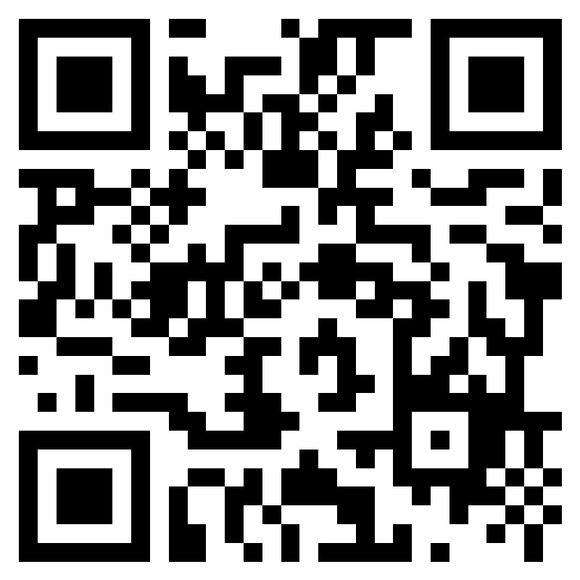
Quick Survey
Do you think that EAGLE will be helpful to you when developing an elder abuse case?
Notes:
Survey link: https://forms.office.com/r/5VSvE7M05S
It would be the trainer's individual responsibility & their institution's, to make sure that trainees passed the course. They will be the ones to issue a certificate pre/post test etc.

Slide 38
Acknowledgements
Deputy Ron Gardner, Harrison Co. Sheriff's Department Gulfport MS
Chantelle Smith, (retired) Assistant Attorney General at Iowa Attorney General's Office
Detective Steven McGee, Paradise Valley AZ PD
Dr. Mosqueda, MD, Keck School of Medicine of USC
Shelly Jackson, PhD, U.S. Department of Justice Elder Justice Initiative
Julie Childs, JD, LLM, Amentum LPM, Consultant to U.S. Department of Justice Elder Justice Initiative
Andy Mao, JD, National Elder Justice Coordinator, U.S. Department of Justice Elder Justice Initiative
National Clearinghouse on Abuse in Later Life (NCALL)
National Center on Elder Abuse (NCEA)

Slide 39

Contact Us
We want to hear from you!
Give website feedback or suggest content
We are always open to collaboration
Email: eaglehelp@usc.edu
Website: www.eagle.usc.edu
Twitter: @EAGLEatUSC

