Slide 1


Investigating Elder Financial Fraud

Slide 2
Case Study
King County, WA, sheriff’s deputy is dispatched to a report of fraud. Reporter is daughter of 79-year-old victim who lives alone and has memory issues.
Daughter stated that two weeks earlier, two men knocked on father’s door, said they owned a construction company. Said there was a hole in roof and offered to repair it for $15,000. Victim agreed.
Over the next two weeks, the men knocked on victim’s door almost daily for various additional jobs (i.e., repairing siding, building concrete path, installing porch.) Completed minimal work to gain victim’s consent, but the work was very poor quality.

Slide 3
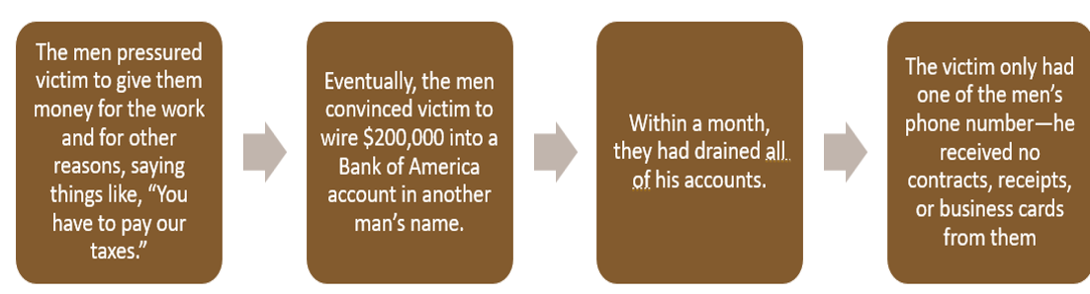
Case Study

Slide 4
Case Study
The patrol deputy wrote a report. Case was assigned to a detective. Thinking the case was civil, detective consulted a prosecutor who advised pursuing the investigation.
The detective drafted search warrants and seized $200,000 in funds from the account in which the victim wired assets. The detective photographed/documented the “repairs” allegedly made
Detective referred the case to the FBI. They opened a case.

Slide 5
Case Study
Working with local police, the FBI linked perpetrators with other similar roofing scams in other states. Total lost among the five victims identified was more than $1M.
The US Attorney’s Office in Western WA charged the two perpetrators with conspiracy to commit wire fraud and wire fraud. Defendants pled guilty and were sentenced to 18 months each in prison, with full restitution to the victims.
In October 2025, the men were also charged in federal court in NY in connection with the same roofing scam.

Slide 6
What is Elder Financial Exploitation?
The illegal or improper use of an older person’s money, property, or assets for another person’s profit or advantage.
Elder financial exploitation consists of:
Elder financial abuse - trust relationship
Elder financial fraud - stranger
Notes:
Specifically, elder financial exploitation involves a perpetrator targeting an older adult due to age or disability to obtain money or assets in violation of a trust relationship with them or as a stranger. Elder financial exploitation can be divided into two primary categories: elder financial abuse, or abuse within the context of a trust relationship and elder financial fraud and scams, which are offenses perpetrated by a stranger.
Law enforcement and prosecutors view the perpetrator’s actions in unlawfully taking, deceiving, or embezzling the assets of the older adult through the lens of state and federal criminal laws to determine whether to file criminal theft, fraud or exploitation charges against the perpetrator in criminal court.
This module will cover elder financial fraud and scams.

Slide 7
What is Elder Financial Fraud?
The act of obtaining money, property, or other benefits through deception or misrepresentation
Schemes commonly referred to as “scams” are a form of fraud
Throughout this training, the term “fraud” will be used to describe scams and other deceptive schemes targeting older adults
Notes:
Elder fraud and scams are perpetrated by a stranger or someone else outside of a conventional or legally defined trust relationship.
Fraud refers to any suspicious activity that you didn’t know about or authorize. This might include someone using your debit or credit card number to make unauthorized purchases, logging into your account and locking you out, or identity theft.
In scams, scammers convince you, through misrepresentation and other tactics, to authorize a transaction or willingly hand over personal information.

Slide 8
Elder Financial Fraud
Is particularly challenging for victims and law enforcement because:
Perpetrators appear to come out of nowhere, targeting unsuspecting victims in the privacy of their own homes
Perpetrator is often in another state or country, impossible to locate once theft is accomplished
Burden is on victim to report, explain what happened, attempt to repair ruined credit, protect accounts, recover stolen funds
Stolen funds are rarely recovered
Perpetrators often use sophisticated tactics to induce victims to turn over their assets or financial information. Common tactics are lying, developing trust, manipulation, grooming, creating a sense of urgency and fear, pretending to be an authority figure, and creating a sense of emotional pressure in order to facilitate the fraud.
To those untrained on responding to these cases, they can incorrectly appear to be consensual or “civil” and not criminal in nature
Notes:
Specifically, elder financial exploitation involves a perpetrator targeting an older adult due to age or disability to obtain money or assets in violation of a trust relationship with them or as a stranger. Elder financial exploitation can be divided into two primary categories: elder financial abuse, or abuse within the context of a trust relationship and elder financial fraud and scams, which are offenses perpetrated by a stranger.
Law enforcement and prosecutors view the perpetrator’s actions in unlawfully taking, deceiving, or embezzling the assets of the older adult through the lens of state and federal criminal laws to determine whether to file criminal theft, fraud or exploitation charges against the perpetrator in criminal court.
This module will cover elder financial fraud and scams.

Slide 9
Fraud Vulnerability
Fraud is perpetrated against people of all ages. All of us, especially when we are lonely, ill, or grieving, are vulnerable to them.
Victims of scams typically feel great shame when they realize they have been victimized. This shame is often compounded when they feel blamed by their families, law enforcement, or APS.
It is vitally important that law enforcement refrain from victim blaming when speaking to victims and their families.
Notes:
Specifically, elder financial exploitation involves a perpetrator targeting an older adult due to age or disability to obtain money or assets in violation of a trust relationship with them or as a stranger. Elder financial exploitation can be divided into two primary categories: elder financial abuse, or abuse within the context of a trust relationship and elder financial fraud and scams, which are offenses perpetrated by a stranger.
Law enforcement and prosecutors view the perpetrator’s actions in unlawfully taking, deceiving, or embezzling the assets of the older adult through the lens of state and federal criminal laws to determine whether to file criminal theft, fraud or exploitation charges against the perpetrator in criminal court.
This module will cover elder financial fraud and scams.

Slide 10
Fraud Reports Are Increasing
  According to the Federal Trade Commission (FTC):
    In 2024, Americans over 60 reported losing $2.4 billion to fraudsters
      68% of this was for individual losses of $100,000 or more
    Losses in 2024 were up 26.3% from 2023, and were up 300% from 2020

Slide 11
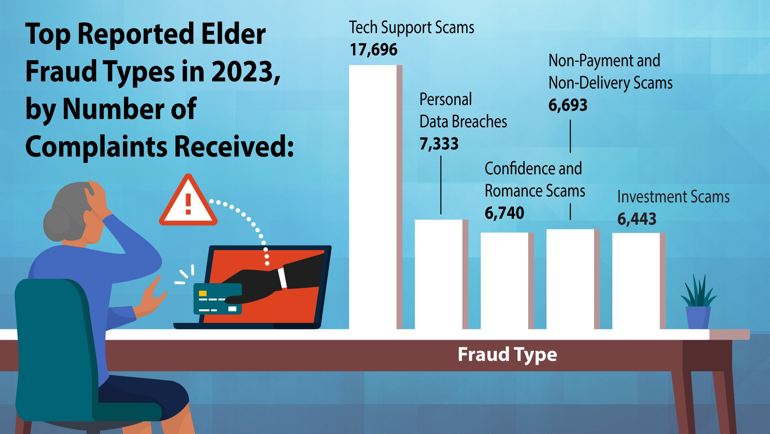

Slide 12
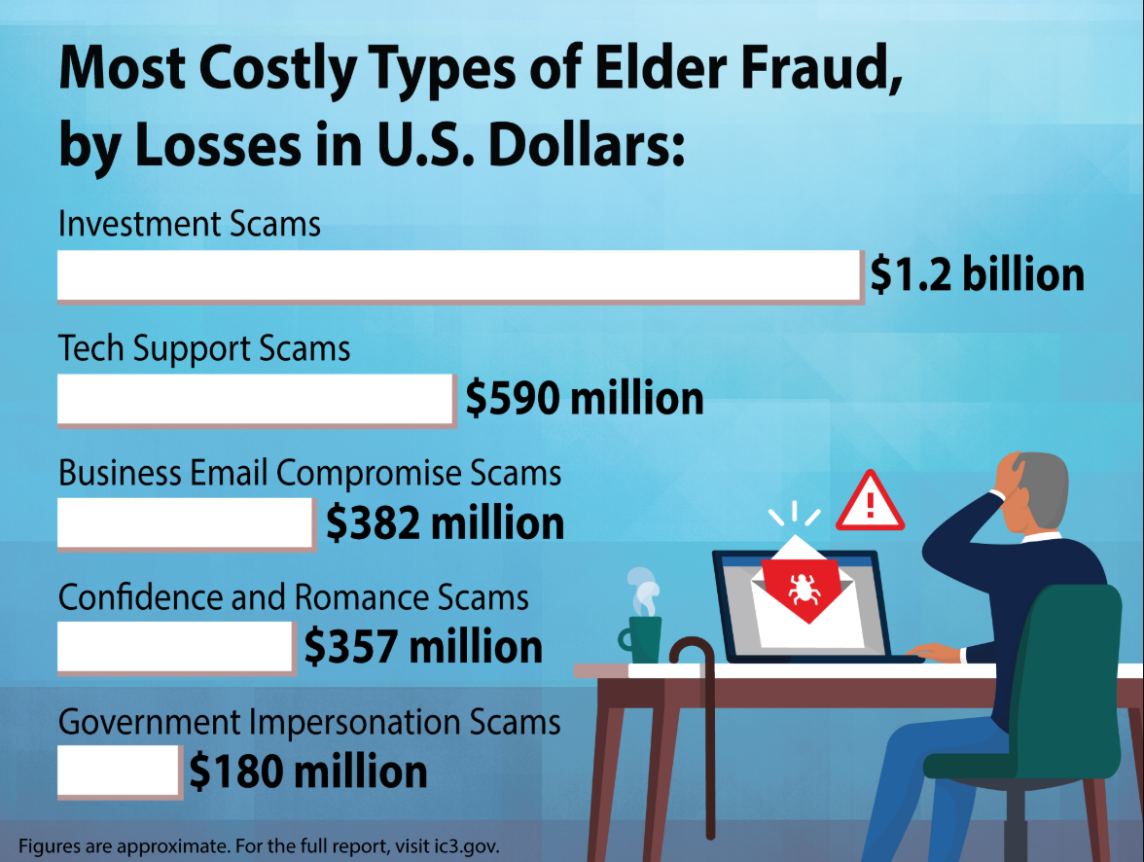

Slide 13
Common Characteristics of Older Victims of Financial Fraud
Chronic health condition
Dementia (often undiagnosed)
Functional deficits and frailty
Assume others are acting in good faith
Socially isolated (recently widowed / live alone)
Lacking knowledge and information about scams and fraud prevention
Accumulated assets

Slide 14
Common Types of Elder Fraud
Investment Scams
  Call / text / message about investment opportunity with amazing rate of return, but only if the victim acts fast. May couple with romance / confidence scam.
Tech Support Scams
Computer pop-up warning of security breach, demand of victim to pay money to cure.
Government Imposter Scams
Scammer claims association with IRS, FTC, Social Security, IRS, Medicare, or court, and demands money in response to victim’s “wrongdoing,” e.g., missed jury duty.
Gold Bar/Courier
Variation on government imposter scam. Scammer poses as government official and convinces victim to transfer money into “government protected account,” often in gold bars. Sends courier to pick up gold bars from victim.

Slide 15
Common Types of Elder Fraud/Scams
Sweepstakes, Charity, Lottery Scams
Scammer claims victim won lottery or inheritance, but only if victim pays taxes/fees.
Refund and Recovery Scams
  Scammer approaches fraud victim and claims scammer can get victims’ money back, but only if victim pays more money.
Confidence/Romance Scams
  Scammer meets victim online, professes interest (often romantic) in them. Has tragic story (i.e., serves in military and is stranded overseas) and asks for money. Variation: grandparent scam.

Slide 16
Common Types of Elder Fraud/Scams
Robocalls/Phone/TV/Radio Scams
Use of spoofing and cloning to defraud the victim.
Home/Car Repair Scams
See case example. Perpetrator falsely claims victim’s home or car need urgent repairs, can do the repairs immediately. Overcharges victim, and often causes more damage in order to obtain higher payment.
Cryptocurrency Scams
  Variety of fraudulent schemes in which scammer fraudulently obtains victim’s assets by exploiting the mostly unregulated and often misunderstood nature of cryptocurrency. Common tactics include guaranteed high-return investment opportunities, fake giveaways, romance "pig butchering" scams, and impersonating officials to demand payment via crypto ATMs.

Slide 17
Perpetrator Tactics
Misrepresenting facts or identity
Befriending victim, undermining victim’s relationships with trusted others
Fostering secrecy, trust, and intimacy
Appealing to victim’s desire for autonomy and independence, or financial security
Threatening victim with legal action
Demanding victim act fast; extracting immediate time-sensitive responses
Inducing heightened emotions
Requiring the victim to pay in a particular way, i.e., gift cards, cryptocurrency, wiring money, payment app

Slide 18
How is Elder Financial Fraud Perpetrated?
Phone calls / text messages from call centers, also called fraud factories
  In other countries including India, Cambodia, West Africa, Laos, Myanmar
  Often in form of imposter calls
  Workers may be victims of human trafficking
Online
  Online ads, popups, emails, dating sites, social media (often sweetheart scams)
In-person
  Door to door, shopping center parking lots
  Fraudsters pretend to be contractors, car repairmen, charities
Mail
Publisher’s Clearinghouse, other fraudulent contests

Slide 19
Why Older Victims Often Don’t Report
Shame
Love, responsibility for perpetrator
Fearful of repercussions
  Anger of family members
  Loss of control of finances
  Loss of independence
  Forced to move into a facility
Dementia — unaware of their actions, unable to appreciate the consequences, unable to process the information
Loneliness, seeking companionship — can impair judgment and cause elder to change spending and gifting patterns
Familial, societal judgment

Slide 20
Impact of These Crimes on Older Victims
Older victims experience:
Loss of life savings
Loss of residence
Loss of trust in others, themselves
Loss of sense of security
Loss of Independence
Feelings of fear, shame, guilt, depression, isolation, anger, sometimes leading to suicide

Slide 21
Investigative Pitfalls
“It’s a civil matter.”
“She willingly gave them her money, so it’s not a crime.”
“Local law enforcement can’t do anything about scams.”
“The victim has dementia, so she’s not credible.”
“The victim has dementia, so he can’t testify.”
“No victim, no case.”

Slide 22
Common Assumptions About Elder Fraud
“It’s only a civil matter.”

Slide 23
Acts of Financial Fraud May Be Civil, But They Are Also Criminal
Virtually all crimes can also be the basis for a civil lawsuit
The fact that an act is civil doesn’t mean it’s not criminal
The question isn’t whether it’s civil, but whether sufficient evidence exists/can be obtained to prove a crime

Slide 24
Common Assumptions About Elder Fraud
“This is not a crime because she ‘willingly’ gave them her money.”

Slide 25
It’s a Crime to Obtain Money By Deception
Fraud occurs when a perpetrator lies to another person and obtains money from them based on those lies
This is a federal crime and a crime in every state:
  Theft/larceny by deception or deceit
  Theft/larceny by fraud
  Theft/larceny by false pretenses; or
  Federal wire fraud / mail fraud

Slide 26
Common Assumptions About Elder Fraud
“This is outside my jurisdiction.”

Slide 27
Not All Fraud Is International
Many in-person scams involve local perpetrators, such as:
  Contractor scams
  Car repair scams
  Charity scams
  Investment scams
Many international scams also involve local players, such as:
  Courier scams
  Gold bar scams

Slide 28
Even if International, Local Law Enforcement Can Play a Crucial Role
By responding to these calls and writing reports, local law enforcement can:
  Bring case to attention of federal investigators
  Help FBI link up scams being perpetrated in multiple jurisdictions
  If local suspect is arrested and charged, work with FBI to obtain information from them on the larger scheme

Slide 29
Regardless of Where the Crime Originates, Local Law Enforcement Can Play a Crucial Role
  Write search warrants to claw back victim’s assets
  Connect victim to needed services by contacting family, making report to APS
  Connect victim to Area Agency on Aging and/or Elder Abuse Multidisciplinary Team if victimization continues and/or if victim refuses services

Slide 30
Common Assumptions About Elder Fraud
“The victim has dementia, so she’s not credible.”
“The victim has dementia, so he can’t testify.”

Slide 31
People with Dementia Are Able to Be Effective Witnesses
A victim’s dementia diagnosis does not mean they are not competent to testify
Many victims with dementia are able to testify effectively
Victims’ memories can often be refreshed with their statements and/or notes about what happened
Studies have shown that people with dementia often retain memory of a traumatic event
Notes:
Victims with dementia can provide accurate testimony regarding crimes, particularly if the events were emotionally charged, as long-term memory may remain intact. Evaluation by professionals is necessary to verify capacity, and legal systems generally allow this testimony, using accommodations to support the witness
Mosqueda, Laura. People With Dementia as Witnesses to Emotional Events in Southern California, 2008-2009. Inter-university Consortium for Political and Social Research [distributor], 2015-04-16. https://doi.org/10.3886/ICPSR29042.v1

Slide 32
Don’t Skip the Interview: Victims with Cognitive Impairment
Interview care providers, family, neighbors regarding what victim told them about scam, any witnessed interactions with suspect, signs of victim’s cognitive impairment
Conduct scripted videotaped interview of victim to capture degree of impairment and how it would have been evident to suspect, as close to time of incident as possible (see Interview Guide for Investigators)
If inadequate or no evaluation of victim’s cognitive impairment, talk to prosecutor about obtaining capacity evaluation; coordinate with APS if possible
Law enforcement and prosecutors must act quickly to preserve their testimony.
Notes:
For more information, see EAGLE’s Evidence Collection Checklist

Slide 33
Trauma-informed Interviewing
Prioritize Trust, Rapport, and Safety
  Introduce yourself and explain your role
  Conduct interview in a safe and supportive setting
  Let the older adult know that they can ask questions and request breaks, and seek clarification
Recognize the Effects of Trauma on Memory and Behavior
  Trauma can affect how people recall events, including the order of events, specific details, and emotional responses
  Recognize that trauma responses vary significantly from person to person
Notes:
A trauma-informed approach does not lower investigative standards; rather, it helps officers obtain more accurate information while minimizing the risk of re-traumatization and improving community trust.

Slide 34
Trauma-informed Interviewing
Use Open-Ended, Nonjudgmental Questions
  Begin with prompts such as, "Can you tell me what happened?" rather than leading questions
  Allow the person to tell their story in their own words
  Avoid questions that imply blame, such as "Why didn't you leave?" or "Why didn't you report this sooner?"
Provide Choice and Control When Possible
  Explain the interview process and what will happen next
  Help restore a sense of control to reduce stress and improve communication
Monitor and Respond to Signs of Distress
  Pause when necessary
  Maintain a calm, professional demeanor and avoid pressuring the person to continue
Notes:
A trauma-informed approach does not lower investigative standards; rather, it helps officers obtain more accurate information while minimizing the risk of re-traumatization and improving community trust.

Slide 35
Common Assumptions About Elder Fraud
“No victim, no case.”

Slide 36
These Crimes Can Often Be Proved at Trial Even if the Victim Can’t Testify
A number of states have elder hearsay statutes that specifically address the admissibility of statements of older and/or vulnerable adult victims when they are not available to testify
Talk with your local prosecutor about options in your state. This way we keep feeding them back to the prosecutors and they are, hopefully, more or better informed.

Slide 37
These Crimes Can Often Be Proved at Trial Even if the Victim Can’t Testify
Some of the victim’s statements may be admissible under the hearsay rules even if the victim is unavailable, such as statements that are:
  Excited utterances
  Present sense impressions
  Statements of then-existing state of mind
  Statement of intent
  Statements not offered to prove the truth of the matter asserted

Slide 38
Other Relevant Evidence to Obtain in a Fraud / Scam Investigation
Victim and suspect (if possible) financial records documenting the transaction
Communications between victim and perpetrator:
  Texts, emails, voice mail messages, Facebook/social media messaging
Documents from the perpetrator:
  Letters, bills, contracts, estimates, business cards
Interviews of family, friends, neighbors who observed scammers, witnessed interactions between scammer and victim, spoke with victim about the scam
If contractor scam, photos of work done, estimate of what victim should have paid

Slide 39
Practice Tips
Collaborate with your prosecutor from the beginning of the investigation regarding likely charges, evidence collection, interviews, and the investigation
Seek expert guidance from a capacity expert such as a geriatrician, gero-psychologist, geriatric psychiatrist, or neuro-pyschologist to assess capacity
Seek expert assistance from a forensic accountant to help you identify and analyze the relevant financial records
Talk with your state or regional fusion center to identify intelligence, investigative leads, patterns, and possible connections to other cases.

Slide 40
Reporting Resources for Law Enforcement and Victims
Federal Trade Commission
DOJ National Elder Fraud Hotline: 833-372-8311
IC3 –Internet Crime Complaint Center
State Attorney General’s Consumer Protection Division
Adult Protective Services*
*Know your state’s mandatory reporting laws; in many states, law enforcement is a mandatory reporter to Adult Protective Services

Slide 41
Elder Abuse Multidisciplinary Teams (MDTs)
A group of professionals from across disciplines that meets regularly to staff cases of elder abuse, neglect, and financial exploitation that are particularly challenging, “stuck” in the system, or have fallen through the cracks
Purpose is to coordinate investigations between relevant agencies, and develop a plan to protect victim from further abuse/exploitation
Though they are becoming more common, elder abuse MDTs still do not exist in many jurisdictions
Learn more about MDTs on EAGLE

Slide 42
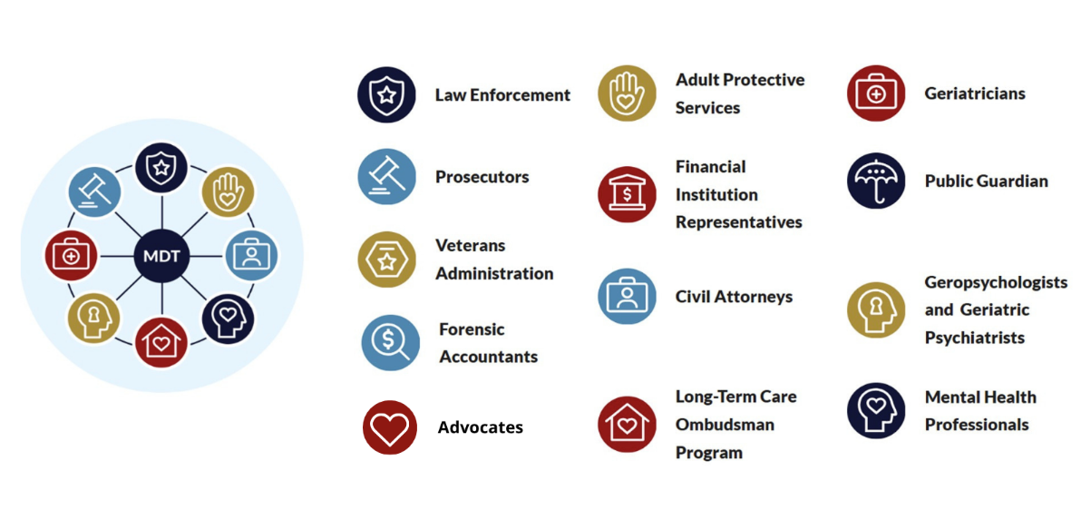
Elder Abuse Multidisciplinary Team Members
Notes:
Elder abuse multidisciplinary teams improve investigation and response through collaboration and coordinated case resolution. Representatives across disciplines meet on a regular basis to collectively address complex cases of abuse.
Teams vary in size, structure, and purpose, often depending upon the community need and available resources. Some teams have a directed focus, such as financial abuse specialist teams (FASTs), elder death review teams (EDRTs), vulnerable adult specialist teams housed in emergency departments, and forensic centers.
Members may include law enforcement, prosecutors, civil attorneys, victim advocates, adult protective services, financial institutions, and medical and mental health professionals.
For more information, visit the EAGLE page on Multidisciplinary Teams.

Slide 43
The Role MDTs Can Play in Cases of Elder Financial Fraud
Assist in identifying resources and options for obtaining a decision-making capacity evaluation when capacity is a concern;
Help connect victims with appropriate medical, behavioral health, and support services;
Connect victims and families with advocacy, support, and available resources;
Coordinate investigative activities and help identify appropriate next steps

Slide 44
EAGLE Resources
Financial Abuse
First Responder Checklist
Evidence Collection Checklist
Interviewing Older Adults
Interview Guide for Investigators
Investigator Interview Checklist
Multidisciplinary Teams
Financial Exploitation Roll Call Video
Community Resource Referral

Slide 45
Additional Resources
Resources for Older Victims
Federal Communications Commission, Stop Unwanted Robocalls and Texts
Senate Committee on Aging, Tools to Protect You and Your Loved Ones from Scams
Federal Trade Commission, National Do Not Call Registry
Better Business Bureau Scam Tracker
Supports for Older Victims
Give an Hour – therapy for victims for financial exploitation
Scams / Consumer Protection — Lifespan
Romance Fraud & Crypto Investment Scam Recovery Groups - Cybercrime Support Network

