Slide 1


Investigating Elder Neglect

Slide 2
Case Study
Victim is in his 80s, suffers from severe dementia, post-stroke. His son is in his 50s, unemployed, and recently evicted. Rather than paying for long-term care, son moves in with victim to provide care. Son barricades victim in his bedroom with no radio, television, or furniture. Bed is a mattress on the floor.
Police go to house anyway, find victim incoherent, lying in filth in overheated room. Call for EMTs. EMTs transport victim to hospital, report he would have died if he’d remained there much longer. Neighbors tell news reporter they’d been hearing victim call for help from inside house for months. No one ever called 911.
Son pays friend to come by once daily to change victim’s diapers. He later hires a visiting nurse, but fires her when she complains about victim’s poor condition. Daughter visits victim, finds him lying on bedroom floor in urine-soaked garbage bag. Daughter calls 911 to report, then calls back to say she talked to an attorney and the family would take care of the situation

Slide 3
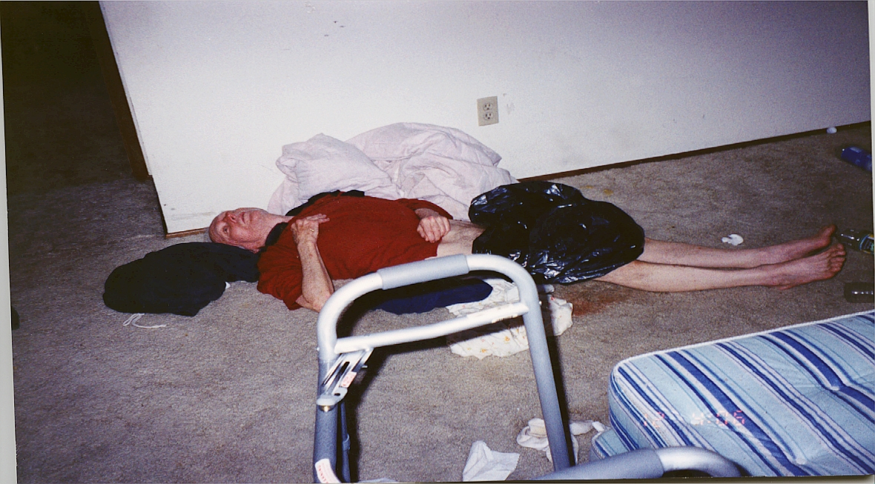

Slide 4
Case Study – Charges and Plea
Son is charged with Criminal Mistreatment 2
(Recklessly fails to provide basic necessities of life to a dependent person and thereby causes imminent risk of great bodily harm or death)
Son pleads guilty as charged, is sentenced to prison. Victim dies soon after son enters guilty plea.

Slide 5
Neglect
General definition: the failure by one with a duty of care to a dependent adult, resulting in harm/imminent risk of harm
One of the most common forms of abuse reported to Adult Protective Services

Slide 6
Self-Neglect
The failure of an adult to adequately meet their own care needs
Can look like neglect except no one has a duty of care to the person
Is not a crime

Slide 7
Self-Neglect: Law Enforcement Response
If you are called to the scene of what appears to be self-neglect:
  Always conduct an investigation to determine whether anyone else is responsible for the older adult’s care
Legal duty of care, i.e., paid caregiver, facility, guardian
    Duty of care created by the caregiver having assumed the responsibility for providing care
Be aware that self-neglect can be an indicator of financial exploitation or some other form of abuse

Slide 8
Self-Neglect: Multidisciplinary Response
Involve other agencies in the investigation:
  If medical or serious mental health concerns, call EMTs
  Report to Adult Protective Services (APS)
  Consider also reporting to:
    Mental health agencies
    Humane Society
    Code enforcement agencies

Slide 9
Criminal Neglect
  Victims are rarely available to testify due to dementia or death
  Cases are, therefore, almost always circumstantial
  Know your state’s neglect crimes
  Consult with involved physician or medical expert to determine that injuries/symptoms are caused by neglect versus underlying disease

Slide 10
Proving Criminal Neglect
  Suspect had a duty of care
  What care should have been provided to the victim?
  What care did the suspect fail to provide?
  Did the suspect have the intent (Mens rea)? (suspect acted with recklessness, criminal negligence)
  Did the suspect’s failure to provide care:
      Cause victim’s harm or death?; or
      Create an imminent risk of harm or death?

Slide 11
Beginning Your Investigation
Where are your first steps?
What evidence should you look for?
What documentation do you need?
Beginning You Investigation

Slide 12
Signs of Neglect
Untreated medical conditions
Multiple pressure ulcers (pressure sores, bedsores) that are untreated or improperly treated
Dehydration
Malnutrition
Lack of available food, water
Soiled clothing
Poor hygiene
Unsanitary and unclean living conditions

Slide 13
Signs of Neglect
Hoarding
Withholding of medications
Overmedicating
Absence of medical necessities, assistance devices
Isolation
Lack of access to phone, radio, television

Slide 14
The Challenges of Investigating Neglect
  Investigating a failure to act, rather than an affirmative act
  Often, there is only circumstantial evidence of the crime
  Crime takes place over a long period of time rather than one event
  Victim is rarely available to give statement or testify
  Abundance of systemic failures
  Requires unique, interdisciplinary approach

Slide 15
What Makes a Case of Neglect a Viable Felony-level Criminal Case?
Pressure ulcers
    Stage III and IV
    Located on front of victim’s body or other unusual locations
    Untreated or improperly treated, infected, odorous
Osteomyelitis
Sepsis
Multiple signs of neglect co-occurring
Financial motivation of perpetrator
    Keeping victim at home to access victim’s income
    Hastening victim’s death to obtain his/her assets
    Avoiding paying for in-home care or care facility

Slide 16
Neglect Investigations: Take Photographs
Injuries
All other signs of neglect
    Pressure ulcers, nails, teeth
Condition of home
    Victim’s bed, bedroom
    Bathroom
    Kitchen
    Suspect’s bedroom
Lack of assistive devices
All the evidence you plan to collect

Slide 17
Neglect Investigations: Collect Evidence
  Victim’s medications, including over the counter
Victim’s clothing and bedding
Power of Attorney documents – financial and health care
Guardianship documents, wills, trusts
Documents indicating contract for care, care assessment plan, care notes, logs

Slide 18
Neglect Investigations: Collect Evidence of Financial Motive
  Execute warrants for victim’s and suspect’s complete financial records, including investment accounts
    Request records dating back at least six months prior to when takings began
  Consider warrant for victim’s and suspect’s credit reports
  Victim’s check registers, checkbooks (if duplicates)
  Evidence of purchases for suspect’s benefit
  Victim’s will, life insurance policies

Slide 19
Neglect Investigations: Collect Evidence of Victim’s Medical Records
Medical records
  Dating back at least one year prior to incident date
  Nursing notes
  Social worker notes
  Lab reports
  Photographs
  Primary physician’s records
  Most recent and prior hospitalizations, including discharge instructions

Slide 20
Neglect Investigations: Other Evidence
If relevant and timely:
  Obtain search warrant for suspect’s residence to search for documents related to victim, evidence of recent purchases and financial motive
  Obtain warrant for suspect’s phone for evidence of location, text messages, emails, internet searches
  Obtain warrant for suspect’s laptop for evidence of emails, internet searches

Slide 21
What Other Agencies Can Assist?
Which agencies would you contact?
What information are you looking for?
Beginning You Investigation

Slide 22
Neglect Investigations: Obtain Records from Other Involved Agencies
Adult Protective Services
    Current and prior investigations
State facility licensing agency
Medicaid Fraud Control Unit (MFCU)
Department of Health
Prior police referrals
Fire Department run reports

Slide 23
Neglect Investigations: Collaborations
Consult early on with:
Prosecutor
APS investigator
Medical expert
Other relevant experts

Slide 24
Neglect Investigations: Interviews
Victim, if possible
Primary care physician
ER physicians, nurses, social workers
EMS Personnel
Agency caseworkers
Family members, neighbors, friends
Caregiver agency supervisor (suspect’s employer)
Suspect

Slide 25
Basic Concepts To Keep In Mind
The victim’s body and location are the crime scene
Anticipate and prepare for suspect’s defenses

Slide 26
What Defenses Should you Anticipate?
What are the most common defenses asserted in cases of neglect?
How would you respond?
What evidence should you collect?

Slide 27
Common Defenses: Consent
  Most common defense raised in neglect cases
    “I promised her she wouldn’t have to go to the hospital or a nursing home.”
    “He wanted me to leave him alone. I was just following his wishes.”

Slide 28
If the Victim had Cognitive Impairment
If victim suffered from significant dementia and suspect knew/should have known of the condition, a defense of consent will be of little value
Review victim’s medical records for:
    Cognitive screening and evaluations
    Dementia diagnosis
    Whether victim had history of refusing care

Slide 29
Common Defenses: Victim Blaming
Victim-blaming:
  “She was difficult to care for. I did the best I could.”
Caregiver stress is not a recognized defense in any state, but may be raised in conjunction with a mental defense
Work with prosecutor to determine proper avenues of investigation in response

Slide 30
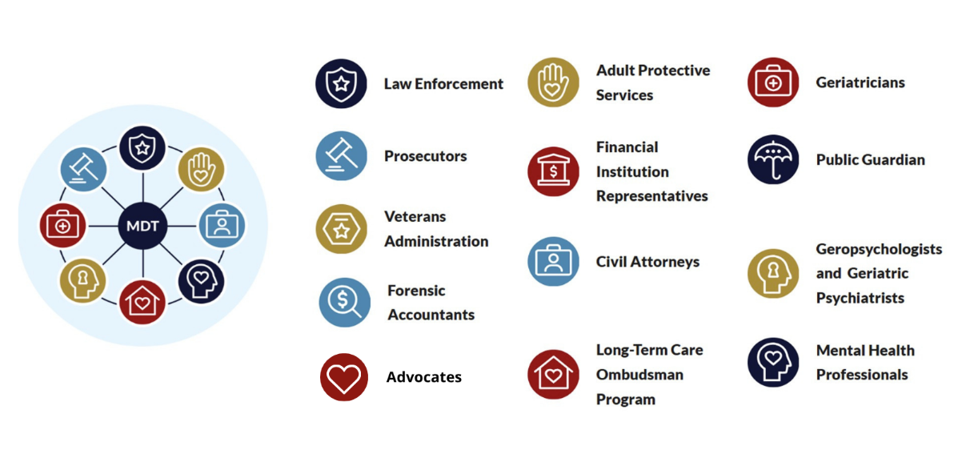
Multidisciplinary Teams

Slide 31
When Your Case Isn’t Getting Traction With the Prosecutor—Some Suggestions
    Ask to meet with the office’s elder abuse prosecutor
    If there isn’t one, ask to meet with the prosecutor who handles financial crimes
    If the prosecutor won’t engage, ask for a meeting with the elected prosecutor and an APS supervisor to request that the office designate a prosecutor to handle elder financial crimes. Bring case examples with you.
    Participate in your community’s MDT
    Ask your prosecutor’s office to send a prosecutor to the National Institute on the Prosecution of Elder Abuse (see handout)

Slide 32
Practice Tips
Collaborate with your prosecutor from the beginning of the investigation regarding charges, evidence collection, interviews, and the investigation
Educate yourself about elder abuse, training opportunities, and resources and share that information with your department and prosecutor’s office
Because consent is so often the defense, be sure to fully investigate the victim’s capacity by obtaining relevant records, conducting a videotaped interview and, if needed, obtaining a capacity evaluation
Get help from a forensic account
Learn about and stay focused on the victim’s concerns, values, and wishes

Slide 33
Summary
In any case of neglect or self-neglect, always investigate to determine if a crime has been committed
Collaborate with other agencies
Look for evidence of financial motive
Look for co-occurring forms of abuse

Slide 34
EAGLE Resources
Financial Abuse
First Responder Checklist
Evidence Collection Checklist
Elder Abuse and Neglect Injury Documentation Tool
Documenting Bed Sores
Bruising Identification Chart
Interviewing Older Adults
Interview Guide for Investigators
Investigator Interview Checklist
Multidisciplinary Teams
Community Resource Referral

